Slide 1

Change is Hard, Let’s Talk About It:
A Town Hall About Development
in Lower Gwynedd Township
Notes:
JOHN
Hello, welcome, thanks for coming. Introduce/acknowledge LG Supervisors in attendance.
Thanks to Gwynedd Mercy Univ. for hosting the event. (If Claire is there), thank Claire Warner from MontCo Planning Commission for all her hard work preparing the draft comp plan.

Slide 2
Town Hall Agenda
Township Shares (Presentation)
Overview of the draft Comprehensive Plan.
Summary of the Township’s role in development and commercial revitalization.
Can we do anything about traffic?
Ideas for implementing the Comp Plan recommendations.
After the focus groups, recap what we hear.
You Share (Focus Groups)
What you think about the plan and what you want to see in it.
Focus areas:
  Locations for future growth.
  Where zoning might or should change.
  Traffic concerns.
Notes:
JOHN
Explain we ask that they hold questions until we get to the discussion part of the Town Hall
Audible: explain whether there will be 1 group discussion or breakout into smaller groups, depending on audience size
To start, I will turn it over to Mimi Gleason, our Township Manager, to discuss the draft Comprehensive Plan.

Slide 3
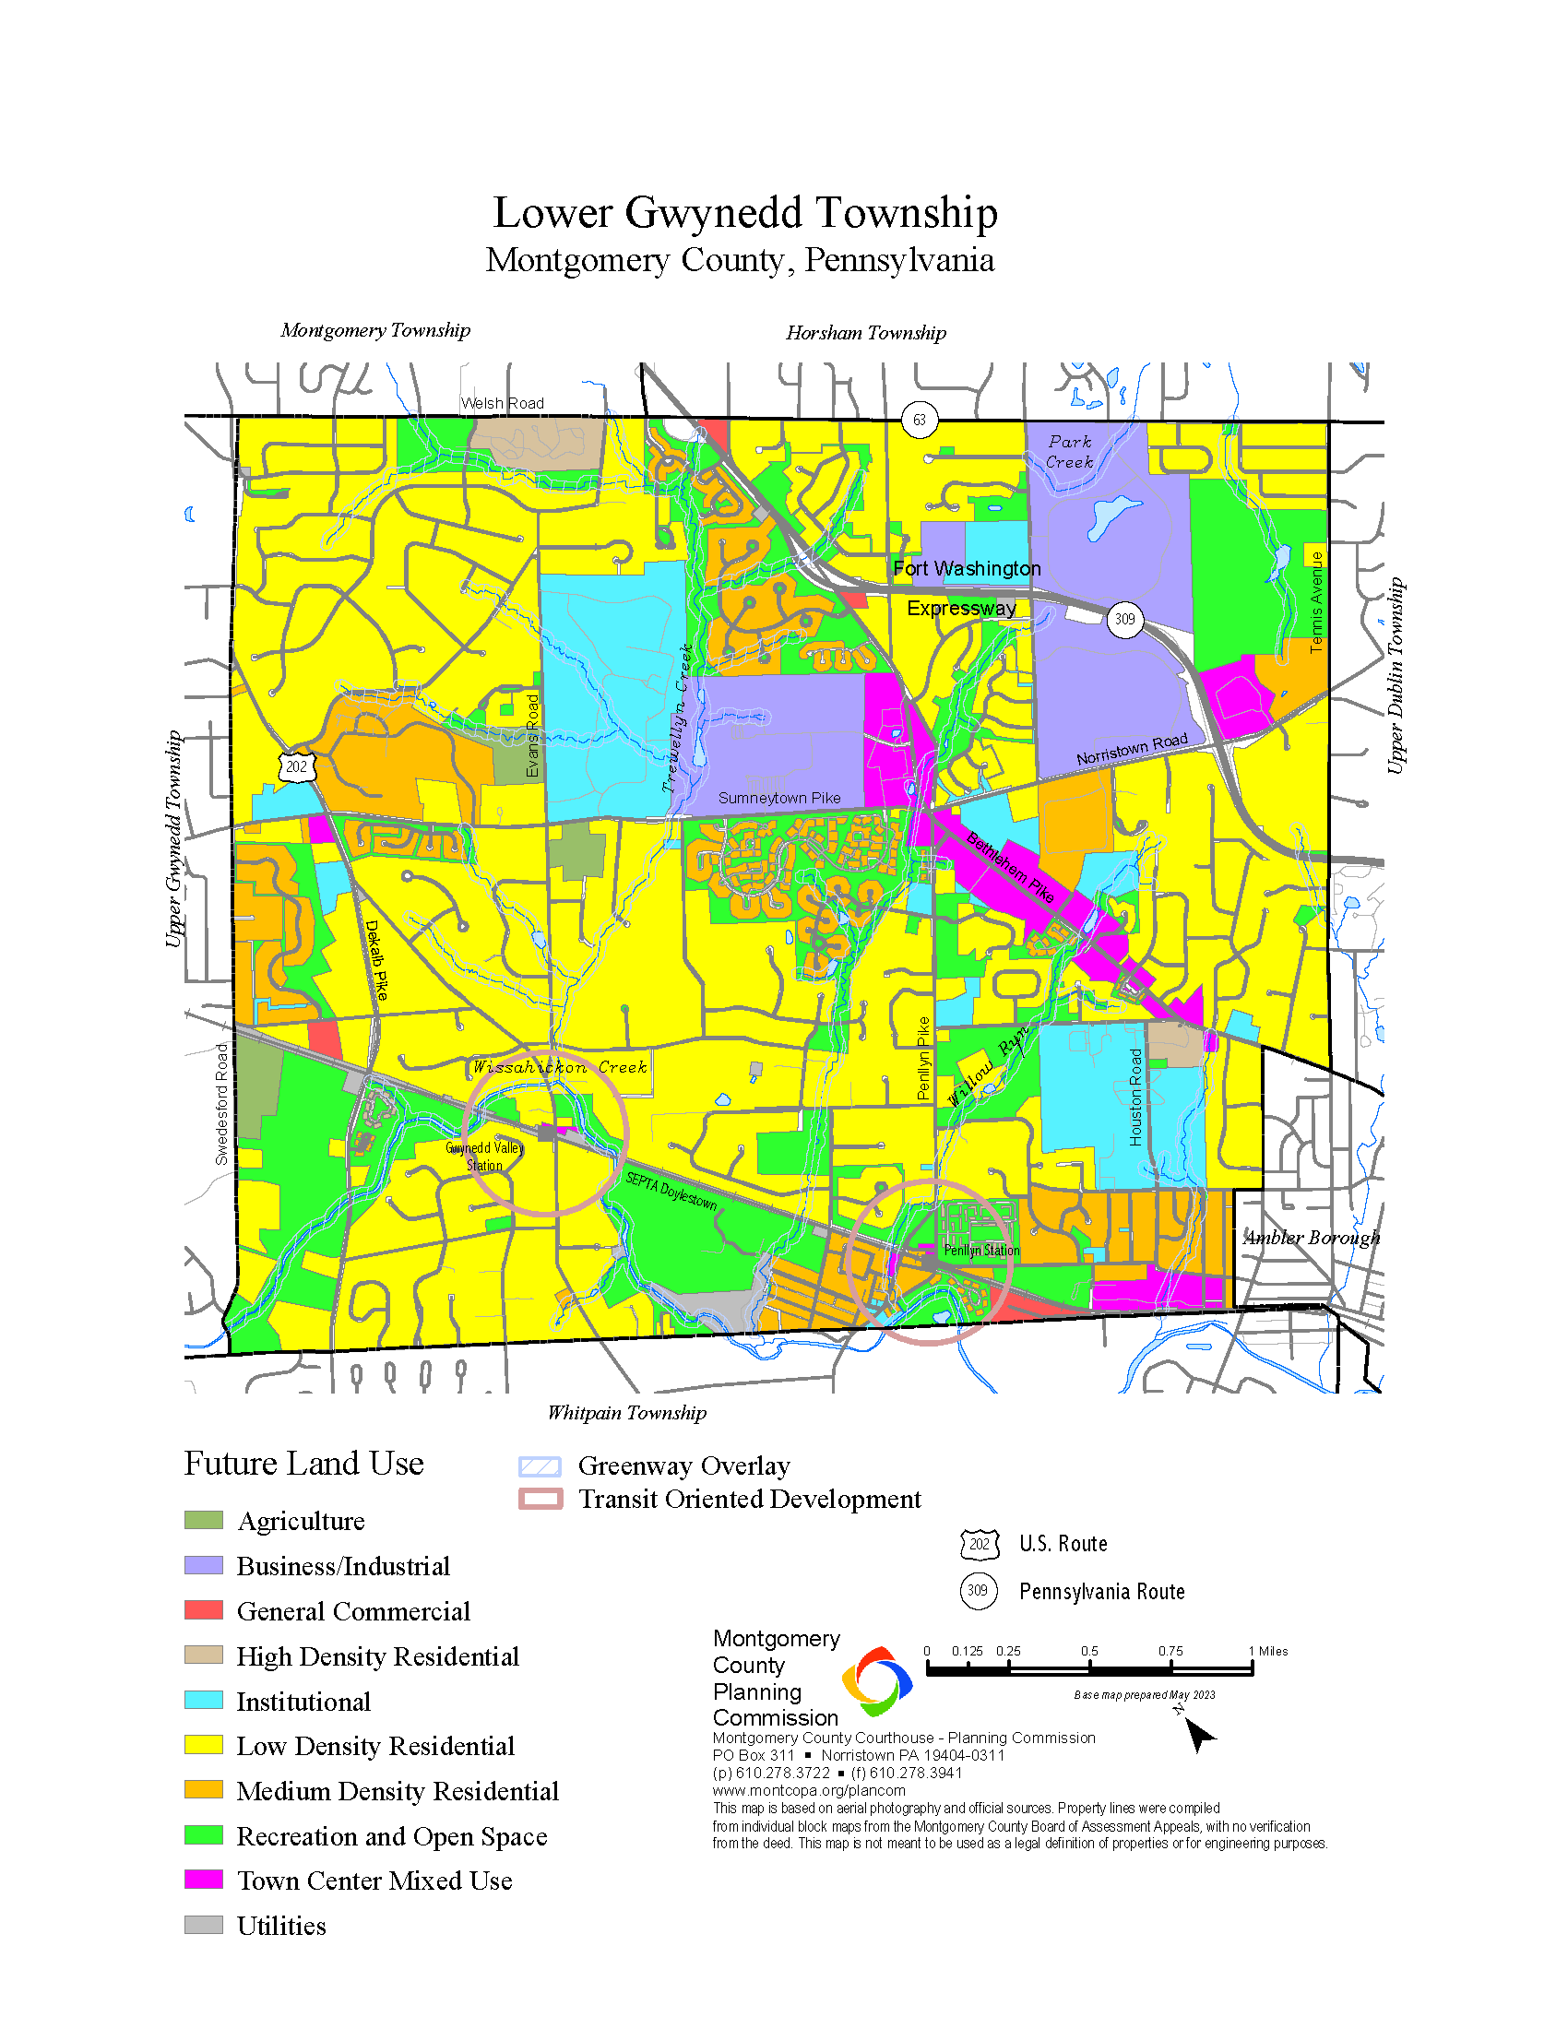
Comprehensive Plan
Guide for next 20 years of (re)development.
Goals similar to last Comp. Plan, which was adopted in 2000.
Result of public engagement that began in 2023.
What is changing?
Notes:
MIMI
The Comprehensive Plan is our high-level guide for development and redevelopment in LGT over the next 20 years.
The goals of this current Comp Plan are very similar to the prior version, which was adopted in 2000. Maintain neighborhoods, revitalize Bethlehem Pike, anticipating possible change to large office/research/industrial businesses that are impacted by the global economy.
Community feedback showed that – People felt strongly that the following things were important- walkability, environmental stewardship, opportunities for small-scale retail and commercial, and sustainable growth. Responders felt that in relation to housing, it was important that there be a balance between creating opportunities for growth in specific areas and maintaining the scale and character of established neighborhoods. Additional feedback received focused heavily on the desire for improved pedestrian connections through trail and sidewalk extensions to destinations.

Slide 4
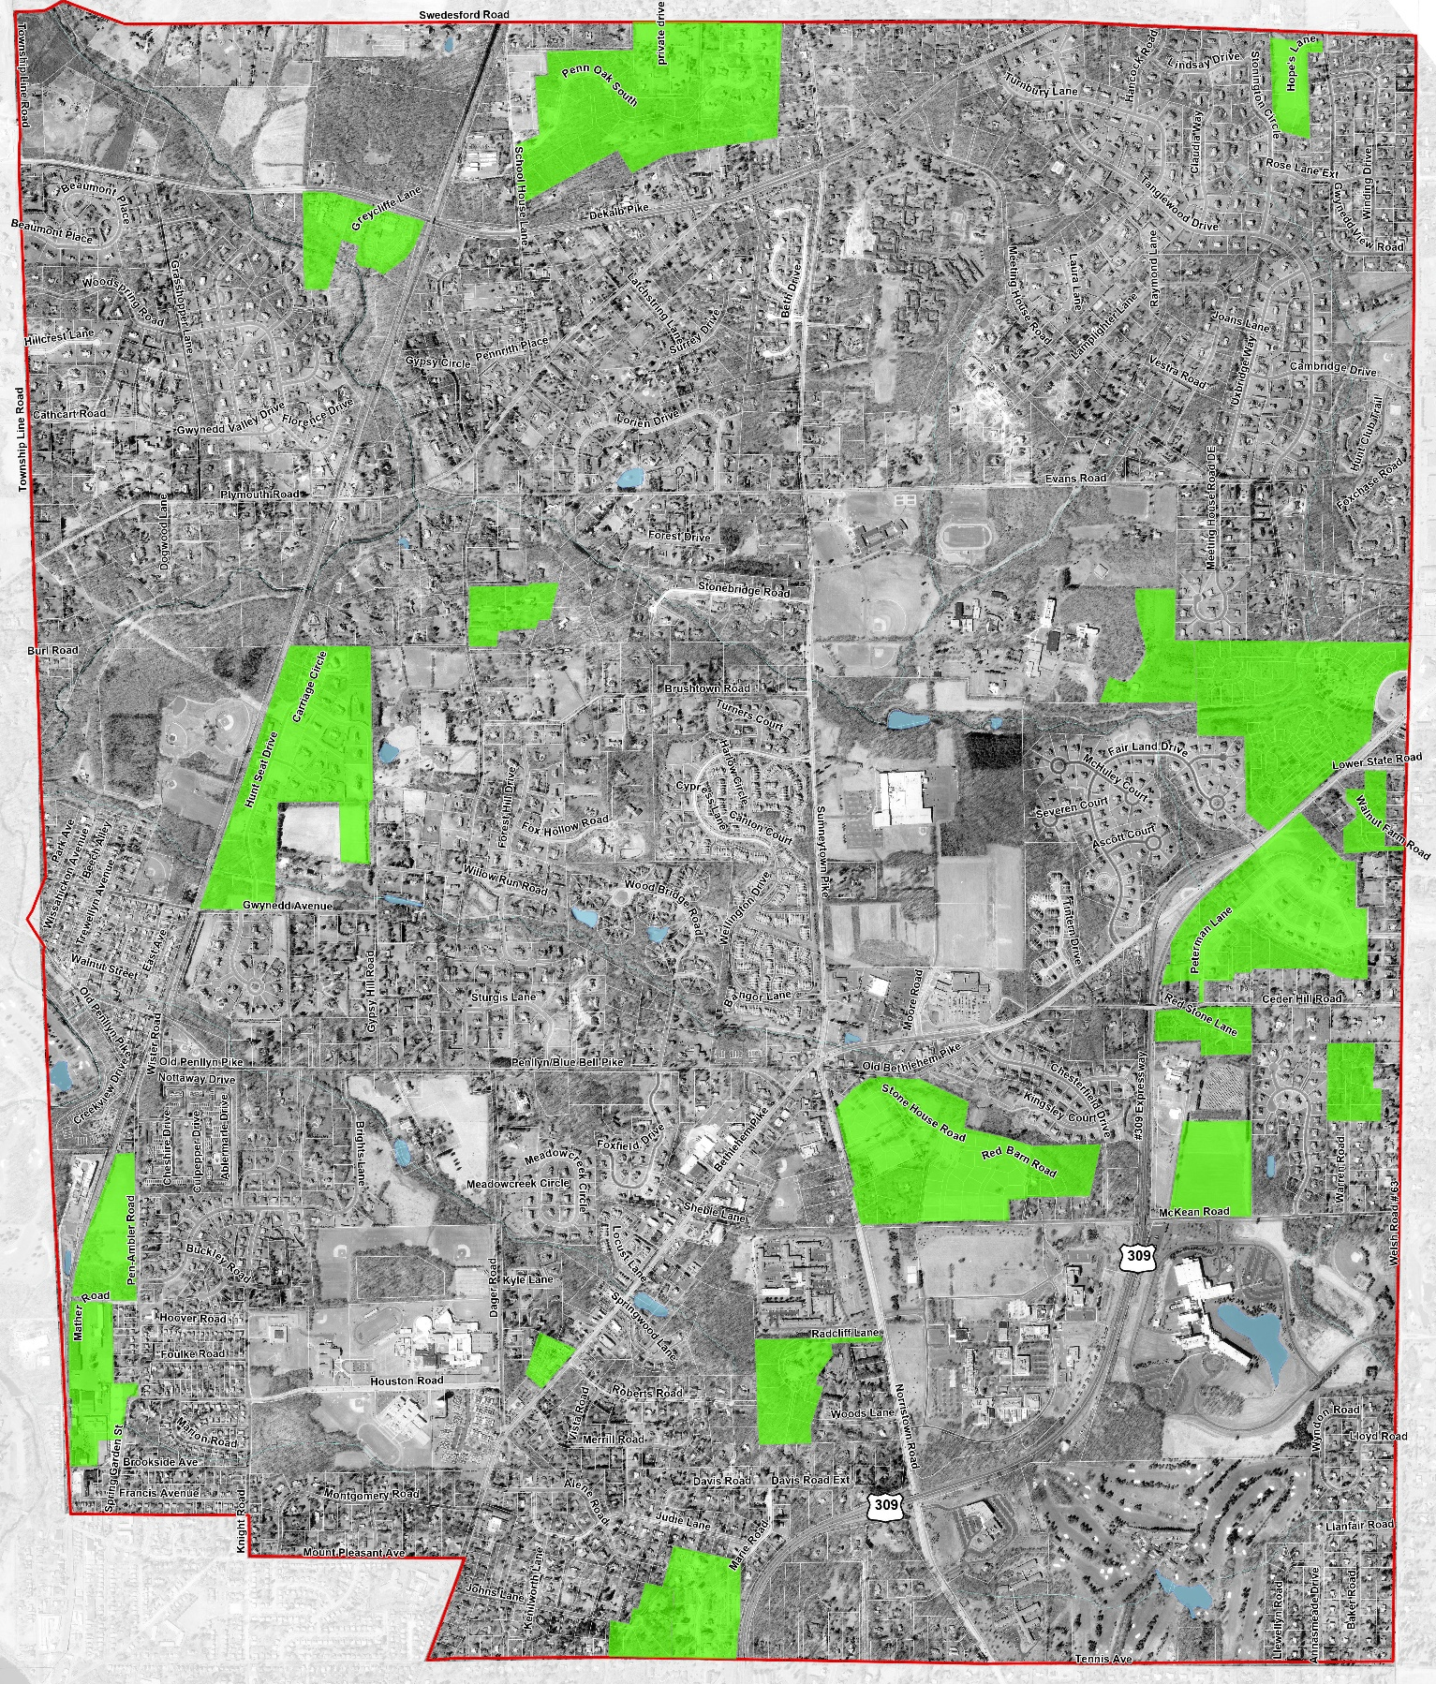
Map:
Development projects from 2000-2025
Notes:
MIMI
This map is a hybrid – the satellite image is from 2000.
The green areas highlight the developments that have come to LGT between 2000 and 2025.
We expect far less development in the next 25 years than we had in the prior 25 years.

Slide 5
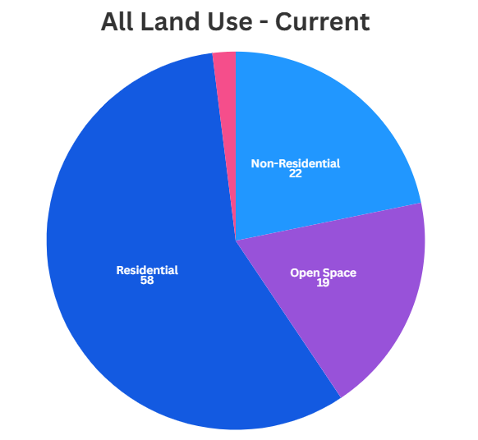
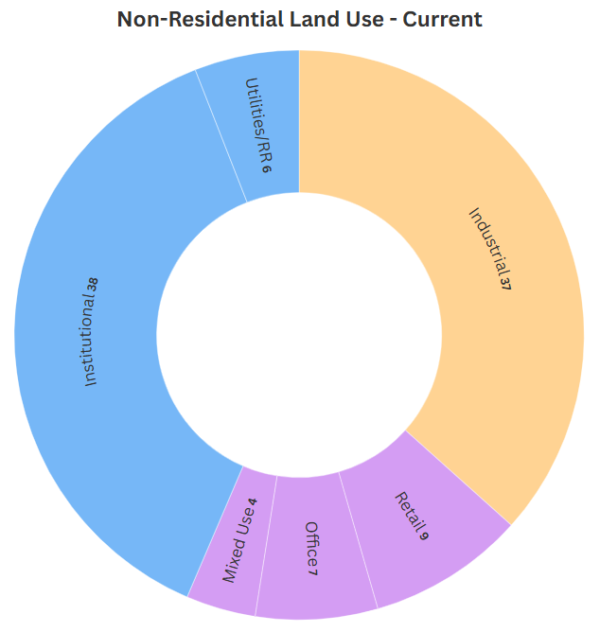





Land Use Breakdown
$$\%$$
$$\%$$
$$\%$$
$$\%$$
$$\%$$
$$\%$$
$$\%$$
$$\%$$
$$\%$$
Notes:
MIMI
Residential is the vast majority of LGT land area – now and in the future
Change is focused on the non-residential, which is only 1/5 of the Township.
Within that 1/5, only 20% is the focus of new or re-development in the comp plan over the next 20 years (about 4% of land area in the Twp) – the rest is expected to stay as large institutions (GMU), industrial areas (AY, SHIP), or utilities and railroads.

Slide 6
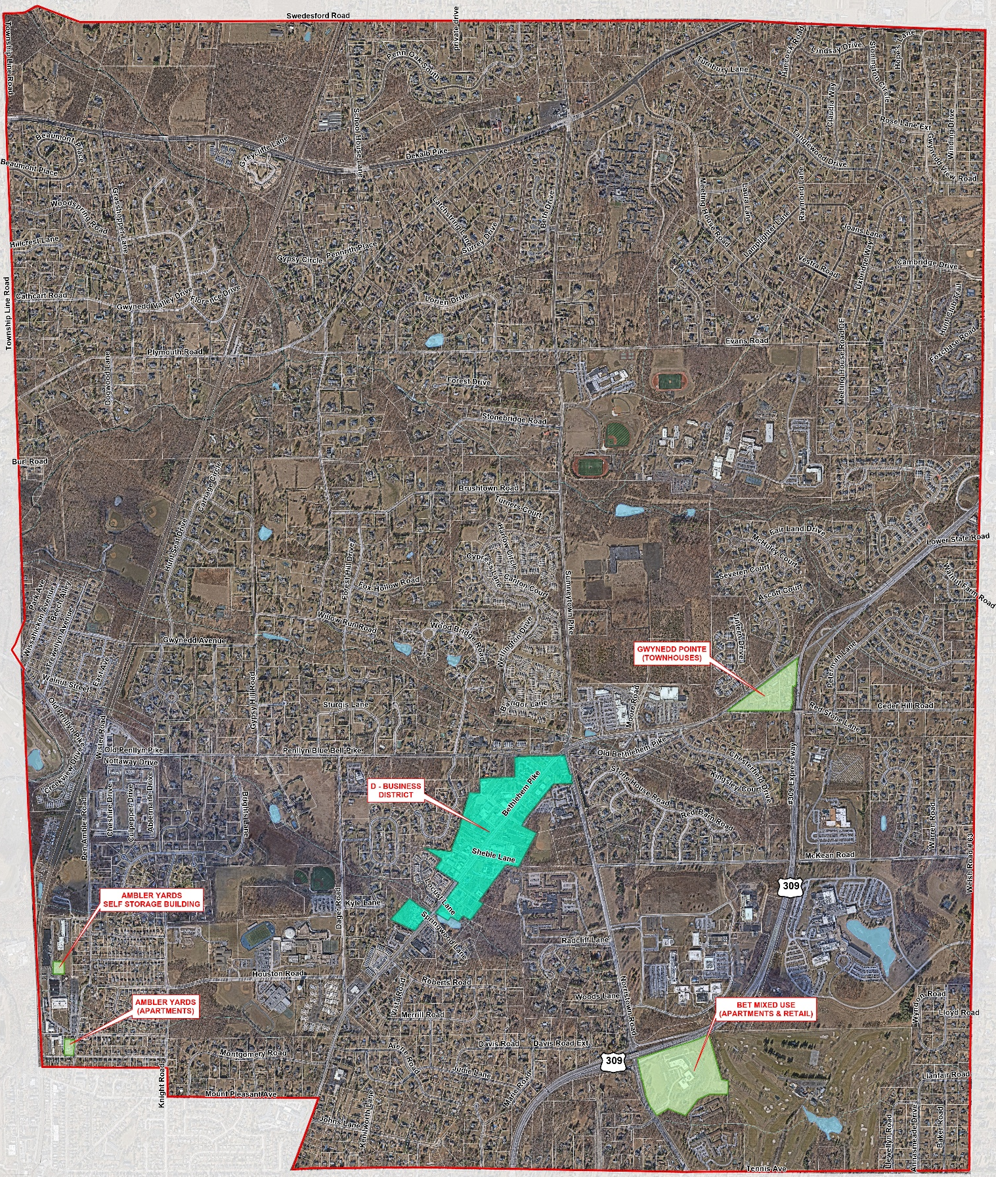
Current or anticipated redevelopment projects
Notes:
MIMI
This map highlights the development projects that are currently in process or expected soon.
Contrast with large number of developments in prior map.
Note that subdivisions may occur under the same zoning that’s been in place for decades, but commercial is most likely focus of redevelopment and only areas likely to be considered for zoning changes.

Slide 7
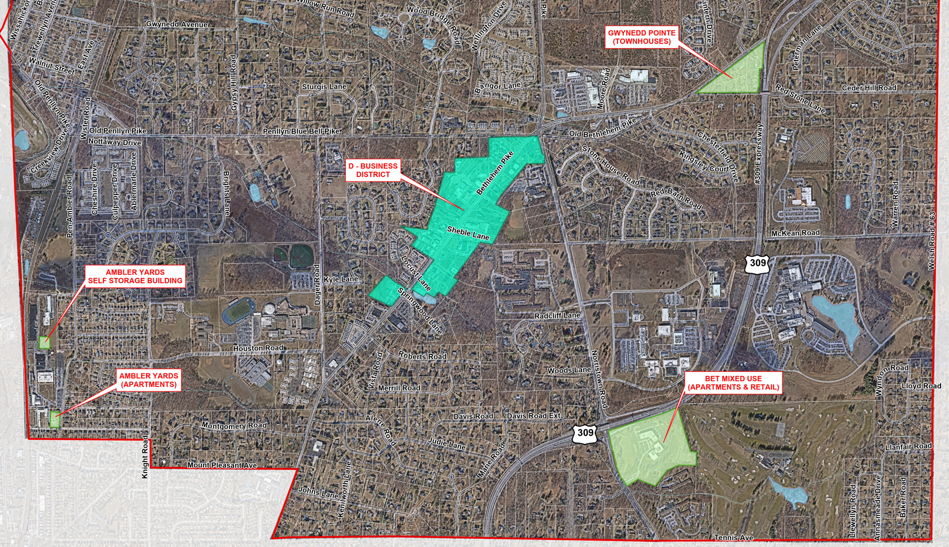
Notes:
MIMI
This version of the map zooms in on the area where the new developments are focused. We will walk through some information about the individual projects on the next slide, and Jamie will be discussing Bethlehem Pike later.
Highlight non-residential focus and that most properties are already developed – therefore most of the change will be REDEVELOPMENT.
Not for presentation - Expect questions/pushback about whether subdividing a 5-acre lot is development or redevelopment.

Slide 8
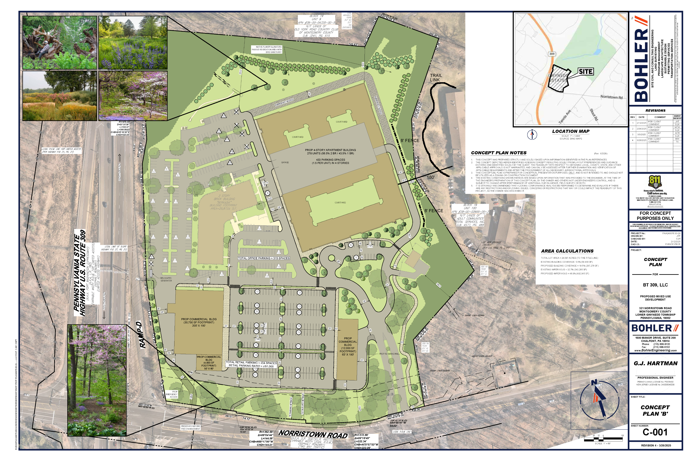
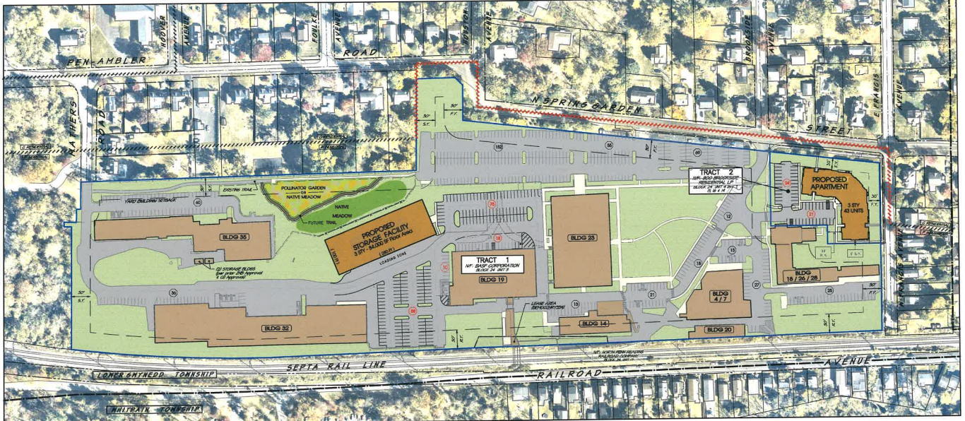
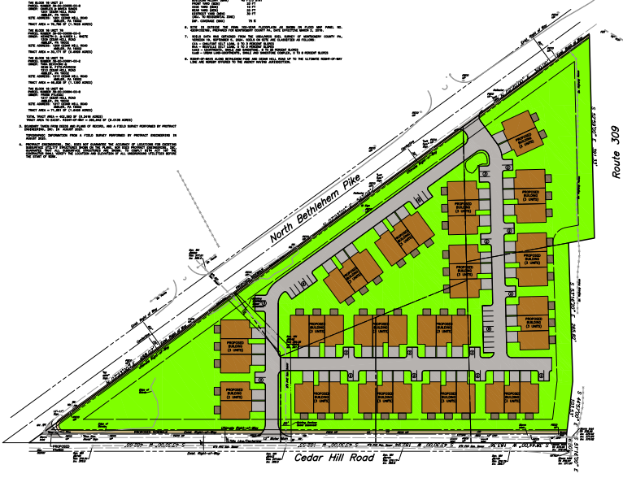
Development on the Horizon
Notes:
MIMI
Weirdly development happening all at once –
While a lot of development is on the table right now, it covers a very small portion of the Township.
These developers are moving ahead before Township takes on zoning.
It is unusual to have this many big developments at once, but it sometimes happens.
Commercial is focus of redevelopment.
The projects on the screen are:
BET (Norristown & 309)
Zoning amendment under consideration – mixed use with 10% workforce housing allocation
Proposed use:
278-unit apartment building with 1 and 2-bedroom options
Rent:
$2,500 - $3,000 / month standard
$2,151 - $2,583 / month WF housing
46,000 sf of retail/restaurant located near Norristown Road
Latest status – haven’t resubmitted
Ambler Yards
Self storage facility
43 apartment units
Penna – Gwynedd Point (309 & Bethlehem Pike, Spring House Nursery)
49 town houses
Note - J&J announcement yesterday, they have purchased the former Sieman’s property at 1201 Sumneytown Pike.
Acknowledge J&J acquisition of Siemans property, no pics - no zoning changes, no plans into Township yet.
Transition to Jamie to discuss zoning.

Slide 9
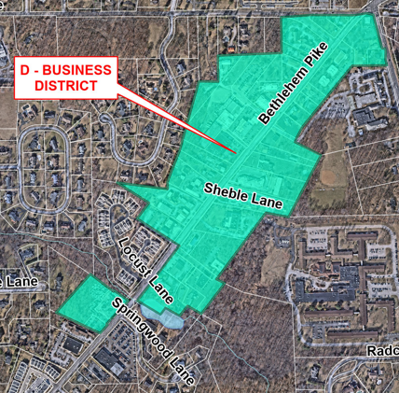
Zoning
By-Right – permitted outright.
Special exception - permitted but requires approval from the Zoning Hearing Board
Conditional Use - permitted but requires approval from the Board of Supervisors
Prohibited - not allowed
Notes:
JAMIE
Zoning can be a tricky thing. Did you know that while we think of Bethlehem Pike as just one district there are about 12 different zoning districts along the stretch of road between the Route 309 bypass and Dager Road. We have multiple residential districts, multiple business districts, professional office districts, municipal districts, and an overlay district. No wonder it is confusing. To simplify the discussion today our focus will be on the most basic business district which we refer to as D-Business District and basically encompasses Spring House.
Uses are broken down into categories:

Slide 10
D Business District
By-Right
Retail Stores
Special Exception
Restaurant and a catering establishment
Conditional Use
Public Garages
Prohibited
Office/Financial
Personal Service Shop
Undertaker
Baker, Confectioner, or custom shop
Medical Offices
Municipal Use
Any use similar to those specified under permitted uses but are not specifically stated
Dog and Cat Kennels
Motor Vehicle Sales
Motor Vehicle Service or Repair
Motor Vehicle Rental or Leasing
Gasoline Service Stations
Parking Lots Incidental to any of these uses
Trucking Terminals
Notes:
JAMIE
Under the current zoning things like breweries, gyms, spas, and daycares are not permitted.
The Township is often contacted by interested business owners who want to open their business along the Pike (and sometimes other commercial areas too) but can’t because it doesn’t fit within the context of the zoning ordinance. It is problematic from a zoning perspective too because it leaves too much up to interpretation.
Ex.- Someone wants to open a quick-service restaurant where they will only offer takeout food. Is it a restaurant? Retail sale of food? If it is permitted as a retail sale of food, what happens when they start to expand by adding tables where someone can wait while they prepare their food and before you know it, they now offer eat-in dining and haven’t gone through the required special exception process and now violate the parking code.
Ex.- Someone wants to open a gym, so they start describing it as individual training, physical therapy and requesting to come in under a private medical practitioner use. It makes it difficult for the Zoning Officer to apply the code and isn’t an accurate description of what the actual use will be once in operation.
When requests for use variances or zoning ordinance amendments become the norm, it is an indication that the zoning code as is, isn’t working. When businesses that are common today in our economy or are popular with consumers are not permitted in a business zoning district, that’s another indication that zoning is out of date. People may also wonder, well if it is permitted by special exception than they could just pursue that process. The problem is, business people understandably don’t want to go through the Zoning Hearing Board process or the Conditional Use process just to see if the type of business they want to open is permissible in that location because it is time consuming and costly, and therefore take their businesses somewhere else. It is much easier to be permitted to do things by right. The Township has the challenge of creating a balance between allowing uses but also having some level of control over how things develop but that could possibly be achieved within the ordinance rather than requiring other extra approval processes.
Develop Design Standards
Façade Incentives
Allowances for things like shared parking or shared spaces;

Slide 11
What is the Township’s role
  Property owners make changes to their properties.
  Township
    Develops a land use plan.
    Enacts zoning and development ordinances.
    Updates zoning periodically to accommodate new land uses.
      Either by initiating ordinance amendments or responding to property owner requests.
Notes:
JAMIE
The Township’s role is mostly planning and permitting.
Property owners, not the Township decide if they want (or need) to make changes to their properties
Twp develops a land use plan, enacts zoning and development ordinances that are consistent with the land use plan and regulate how properties may be developed
Twp updates zoning periodically to accommodate new land uses that have become desirable or needed by the community, because of the economy or changes in tastes or other factors – either by initiating ordinance amendments or responding to property owner applications for zoning changes

Slide 12
What is the Township’s role
Good planning and zoning helps to:
  Preserve the neighborhoods you love.
    Limit new development in those areas.
  Support and revitalize business corridors.
    Change to keep up with the times, but with limits.
  Responsibly manage commercial property upgrades.
    Consider requests zoning updates with an open mind and prioritizing the long-term interests of the community.
Notes:
JAMIE
preserve the neighborhoods you love by limiting (but not prohibiting) the amount of new development that can happen there
support and revitalize business corridors by allowing new uses to keep up with the times and recognizing where small increases in density may be needed to make redevelopment affordable for property owners – but still with limits
responsibly manage commercial property upgrades by considering requests from property owners for zoning updates, listening with an open mind and prioritizing the best long-term interests of the entire community (not just 50 people who show up at a meeting)

Slide 13
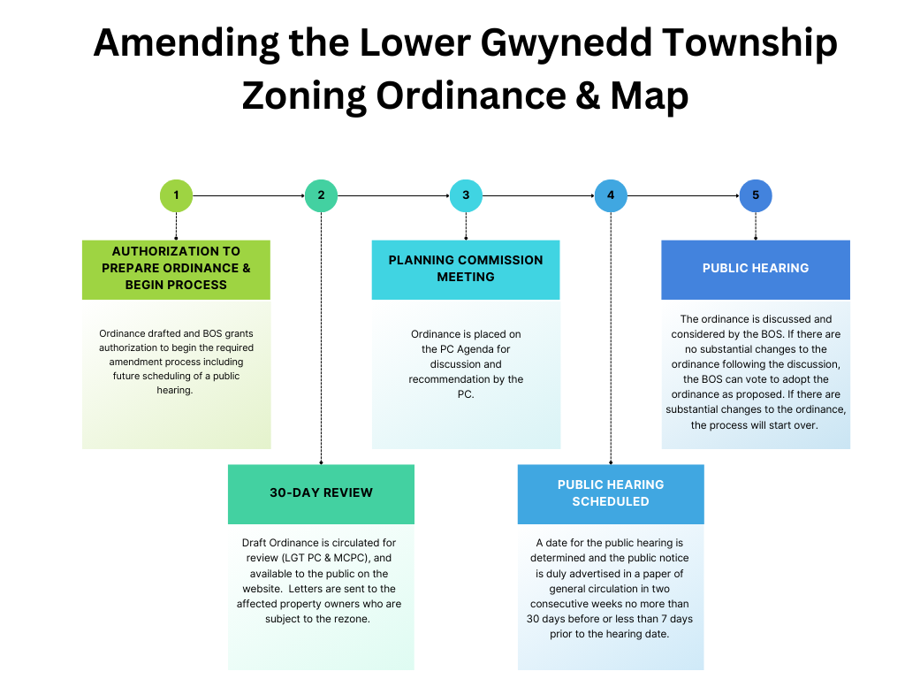
How is Zoning Changed?
Notes:
JAMIE
Walk through process graphic.
Transition to Chad.

Slide 14
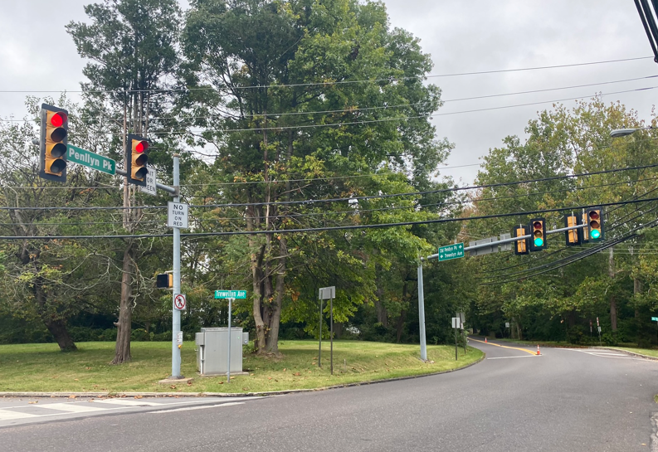
Traffic
What we can do:
  Study/change Township-owned roads/intersections
  Partner with PennDOT and Montgomery County
  Traffic signal upgrades & interconnected systems
    Trewellyn/Penllyn Pike
    Welsh Road
    Norristown/Tennis
    Spring House Adaptive System
  Sidewalks & Trails Plan
Notes:
Study/Improve Township Roads/Intersections
Improvements for traffic control, maintenance and safety (lower volumes/less major capacity needs). Although improvements may not require PennDOT or County approvals, must still follow best practices and state regulations for public roads.
Partner with PennDOT and Montgomery County
Most congestion issues occur along major corridors owned by the State or County, including township owned roads that intersect these corridors.
PennDOT looks for municipalities to be the “lead” on intersection upgrades and smaller corridor projects by completing planning/studies, preliminary engineering/final design, r/w acquisition and utility corridor and pursue state funded transportation grant programs for construction.
Montgomery County takes a similar approach for intersection projects, however the County may take the lead or partner on larger corridor projects dependent on priorities and available funding (explain Ridge Pike corridor projects in the County)
Traffic signal upgrades and smart signal systems
Signal Upgrades – detection systems at intersections for efficiency and safety
Signal Systems – nearly all traffic signals in the township are currently part of an interconnected system (309, 202, Norristown Road/Sumneytown Pike, Spring House)
System Upgrades- Adaptive – currently used for Spring House intersection
How smart traffic signals work – coordinated with communication between intersections for timing and phasing to improve traffic flows along the corridor while providing opportunities for the site streets to cross and enter to corridor
Newer adaptive systems monitor traffic volumes/conditions and “adapt” the timings to optimize traffic flows
Emergency pre-emption is standard technology for emergency responders and is continually inspected for replacement, as needed
Recent/Current/Planned Projects
Trewellyn/Penllyn Pike
Welsh Road – Evans and Darden/SC
Norristown/Tennis
Spring House Adaptive System
Bethlehem/Tennis – currently pursuing grants
Sidewalks & Trail Plan
Strategic plan completed in 2025 that identified priority corridors for sidewalks/trails development and new trail crossing locations.
Will be used as a guide for implementation through land development projects.
Township lead projects will require further and more detailed planning and feasibility evaluation for implementation.

Slide 15
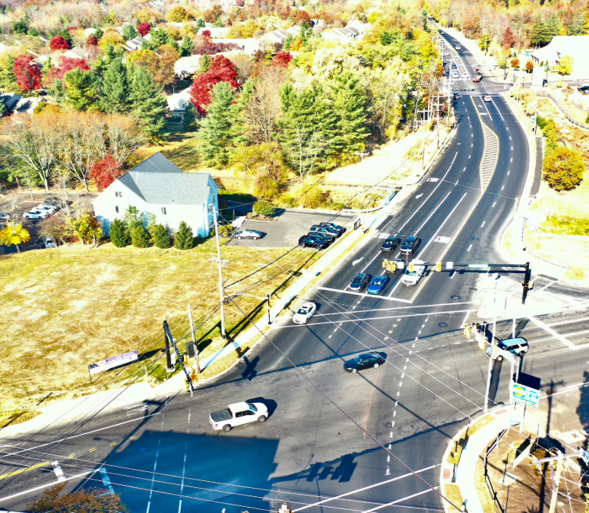
Traffic
Limitations:
  Road Ownership – Township vs. County vs. State
  Physical Barriers, Available Right-of-way
  Cost of Improvements – Available funding
  Time for PennDOT and County approvals, Environmental permitting, and Utility coordination
Notes:
Road Ownership
We work to the best of our ability to make suggestions about what we can do but don’t have ultimate decision authority. PennDOT and County must ultimately approve the scope of improvements and issue permits.
But it is not impossible. LGT widened SH intersection even though roads are owned by PennDOT and MontCo – but it took a long time (8 years) from receiving the first grant to help fund the project.
Physical barriers/Available R/W
Example: Sumneytown variable right of way – need to work with a lot of stakeholders, would need to gain right of way to accommodate growth – would be county, local, individual efforts.
Foulkeways, GMU, Beacon would be key owners of large properties in discussion – focus on one side
Structures/buildings located close to the roadway may impact feasibility or requiring more improvements on one side of the road comparted to the other side
Cost/Funding
Grants strategy and pursuits take time – can sometimes take 2-3 years or more to get awards
Examples of project costs:
Spring House = #3M
Sumneytown Pike = $8-10M (ballpark planning estimate)
Signals Aren’t Inexpensive: Penllyn/Trewellyn $500k+, Welsh Road $400k+
Bridges Costs
Local matches are required – grants are not typically “free money”
Agency Approvals and Permits
PennDOT and County review and approval process
Environmental Permitting adds time and cost items such as stream crossings, wetland, stormwater design, endangered species, historic resources
Utility relocation (Peco, Verizon) takes time and schedule is beyond township’s control

Slide 16
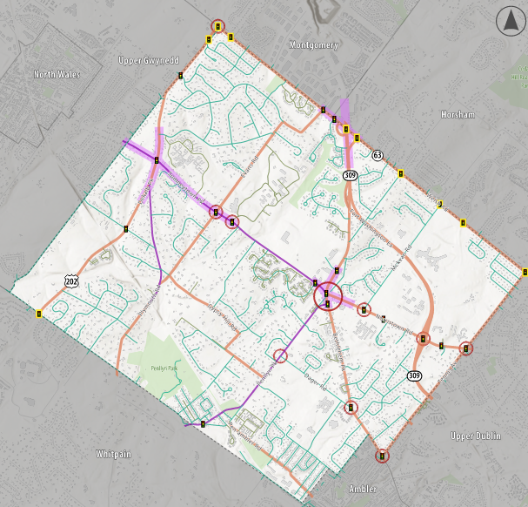
Traffic
Notes:
The map was developed for the meeting tonight to help facilitate discussion on congestion or other traffic concerns for intersections or roadway corridors and provide an opportunity for the public to provide suggestions for potential solutions to be considered in the future.
Road Ownership – the map reflects the roads owned and maintained by PennDOT, Montgomery County, Lower Gwynedd and private HOA.
The map shows that the major corridors in the Township are owned and maintained by:
PennDOT: US 202, PA 309, Welsh Road (PA 63), Norristown Road, Bethlehem Pike, Tennis Avenue, Plymouth Road, Evans Road, Pen-Ambler Road, Gypsy Hill Road
Montgomery: Sumneytown Pike, Penllyn Pike, Plymouth Road
Traffic Signals – owned and maintained by municipalities in PA on ALL roads regardless of ownership. Traffic signals on municipal boundaries are sometimes owned and maintained by the adjacent municipality as is indicated on the congestion map.
The map is not intended to be a precise or comprehensive identification of congestion locations and concerns in the Township.
Congestion locations were identified through a review of the following items:
Recent traffic studies in the township over the past few years.
Regional congestion and travel time data from the Delaware Valley Regional Planning Commission.
“Typical” driving conditions reflected in travel mapping apps such as Google.
Feedback that the Township frequently receives from the public regarding congestion locations in the Township.
The map identifies intersections and segments of roadway corridors with poor levels of services (LOS) or significant queuing issues.
It is important to note that queuing does not always equate to poor LOS or “congestion”. Explain briefly.
The map does not reflect delay experienced on local roads/side streets at unsignalized intersections. We realize that is a concern of residents for the major corridors in the Township such as Bethlehem Pike, Sumneytown Pike, Norristown Road, Penllyn Pike, etc.
Transition back to John

Slide 17
What If We Do Nothing?
Lose the ability to keep commercial properties viable – they must be allowed to modernize.
Local taxes are negatively impacted: commercial development and apartments are good for school and township taxes:
  50% of Township tax revenue is EIT, only 15% is real estate taxes.
Increase the risk of becoming a stagnant community with no development.
Promote conditions that can lead to blighted corridors.
Work against local business people, especially small shops along Bethlehem Pike.
Traffic will still come from other places, even without additional (re)development in LGT.
Developers pay traffic impact fees.
Notes:
JOHN
Lose the ability to keep commercial properties viable – they must be allowed to modernize.
Local taxes are negatively impacted: commercial development and apartments are good for school and township taxes
People who live here and working age are the basis of tax revenue – if you don’t want property taxes to go up, we need more of them.
Increase the risk of becoming a stagnant community with no development.
Promote conditions that can lead to blighted corridors.
Work against local business people, especially small shops along Bethlehem Pike.
Traffic will still come from other places, even without additional (re)development in LGT.
If you assume no development anywhere, population change and increases in car ownership will still generate more traffic.
Development helps to pay for traffic improvements.
Have a list in the notes, but not part of presentation, that shows development from surrounding communities - total number of units or developments surrounding us - Jamie to check with County/neighbors to have high-level stats
About 50% of total Twp tax revenue is Earned Income Taxes; about 15% is real estate taxes.
To have handy if asked: for WSD, EIT = 9%, RE taxes = 66%)
Vacant building reduces real estate & business taxes owed.
Property assessed value has decreased.
More vacancy means fewer employees and business taxes.

Slide 18
How Could Recommendations be Implemented?
FIRST: Bethlehem Pike Revitalization
  Start with straightforward zoning changes in 2026.
  Evaluate need for more complex zoning changes or physical improvements.
  Target: June 9th for first public event.
NEXT: Possibilities for future steps
  Seek grants.
  Identify feasible ways to reduce congestion on Sumneytown Pike.
  Update traffic impact plan.
Notes:
JOHN
Add this slide to give people ideas to discuss in the breakout groups?
FIRST THING: Bethlehem Pike revitalization, based on resident and business feedback
Start with straight forward zoning changes in 2026
Evaluate need for more complex zoning changes or physical improvements (infrastructure, streetscape aesthetics, design standards, façade incentives, walkability, etc.)
Possibilities for future steps
Seek grants, start plan to identify feasible ways to reduce congestion on Sumneytown Pike (county road)
Update traffic impact plan – to identify other road improvements, which then could be partially funded by develop impact fees
OTHER IDEAS????

Slide 19
2 Discussion Groups
Land Use & Zoning:
Where should future growth be directed? What kind of establishments do you want?
Traffic:
Where are your top traffic issues & ideas for solutions?
Notes:
JOHN
0-10 people: One group that rotates through the 2 subjects; stay in seats.
10+ people: Two groups that rotate between 2 subject areas; one group moves to alternate location.
Moderators move, people stay.
Give 10 minutes so people can look at maps and move to breakout rooms.
Get a supervisor at each breakout discussion.
20 min breakout groups. Alarm at 15 min.
Reconvene at end for synopsis.
Comp Plan
3/18 PC
3/24 BOS meeting
Online comments and site to show – call or email
Breakout groups are for big picture issues, not individual drain inlet that is clogged.
Not for particular details of developments.
Development Group
Led by Mimi
Zoning Group
Led by Jamie
Traffic Group
Led by Chad, assisted by John

Slide 20
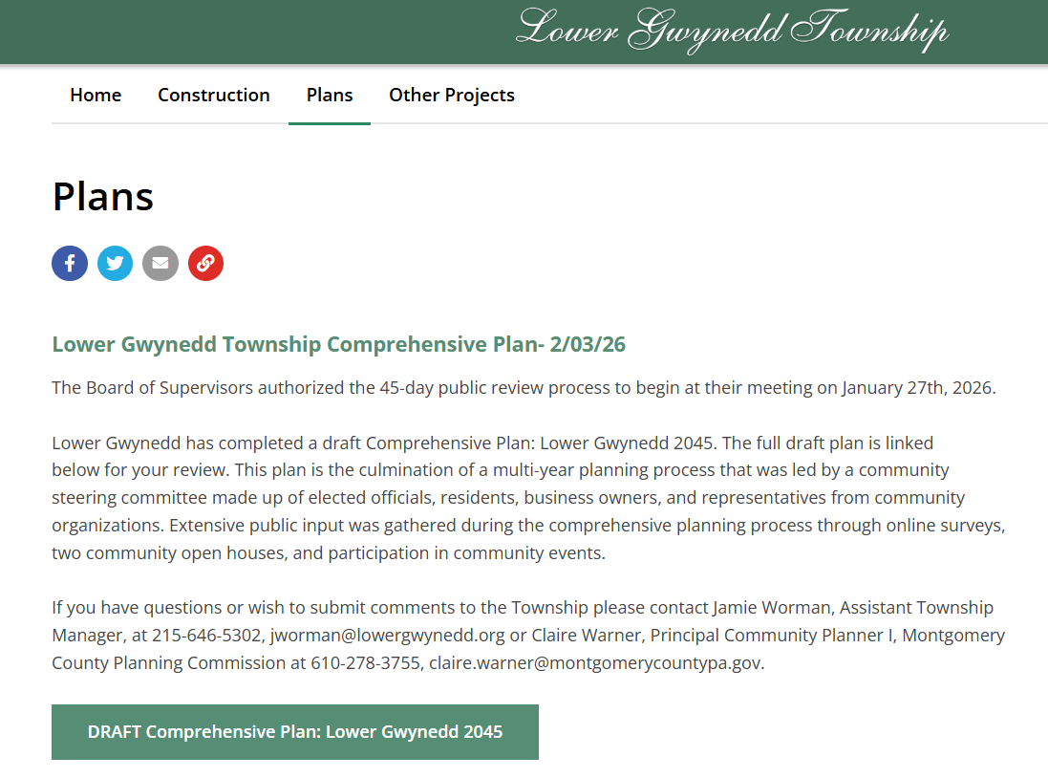
Recap & Next Steps
Dates for Comprehensive Plan Public Discussions
  March 18th – Planning Commission
  March 24th – Board of Supervisors
Submit comments via email or phone call

