Slide 1
Lower Gwynedd
Comprehensive Plan
_______________
Summary, Goals, and Recommendations
March 19, 2025

Slide 2
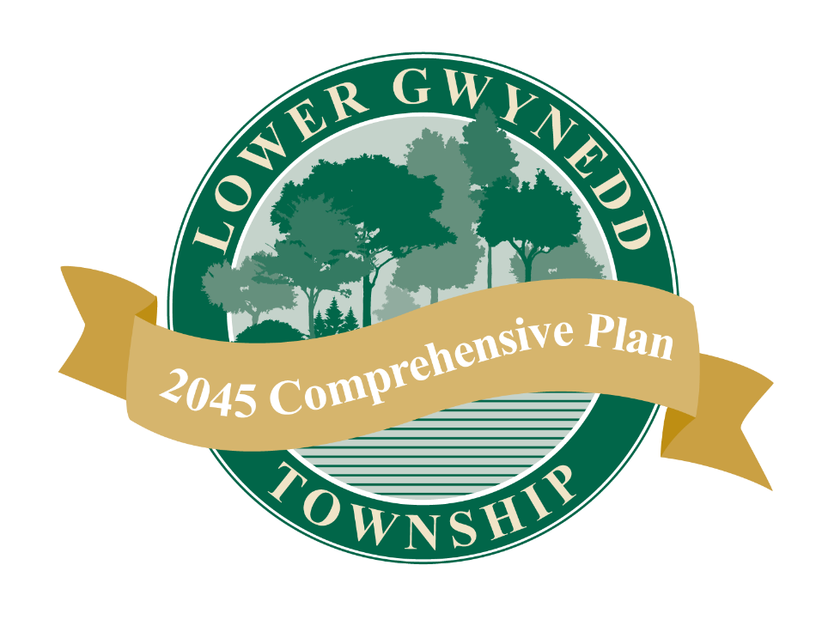
What is a Comprehensive Plan?
Long-range planning document providing a future growth and development guide
Identifies a community vision that guides the plan’s recommendations
Recommendations and implementation strategies are proposed to work towards that vision
Required by the Municipalities Planning Code (MPC) to be reviewed every 10 years
  Geographically comprehensive
  Comprehensive in subject matter
  Long-range time frame
Focus Area Study

Slide 3
Planning Process
Kickoff
Public Engagement Part 1 –Issue Identification
Topic area Analysis
Bethlehem Pike Focus Area
Public Engagement Part 2 – Draft Recommendations
Review Final Plan
Adoption
Topic area Analysis

Slide 4
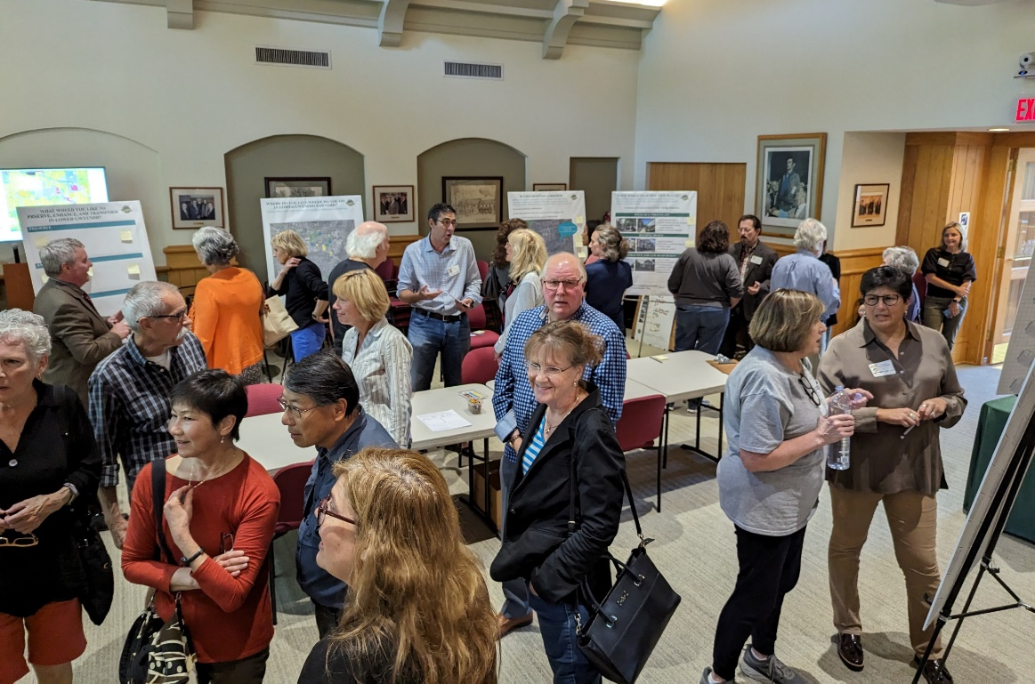
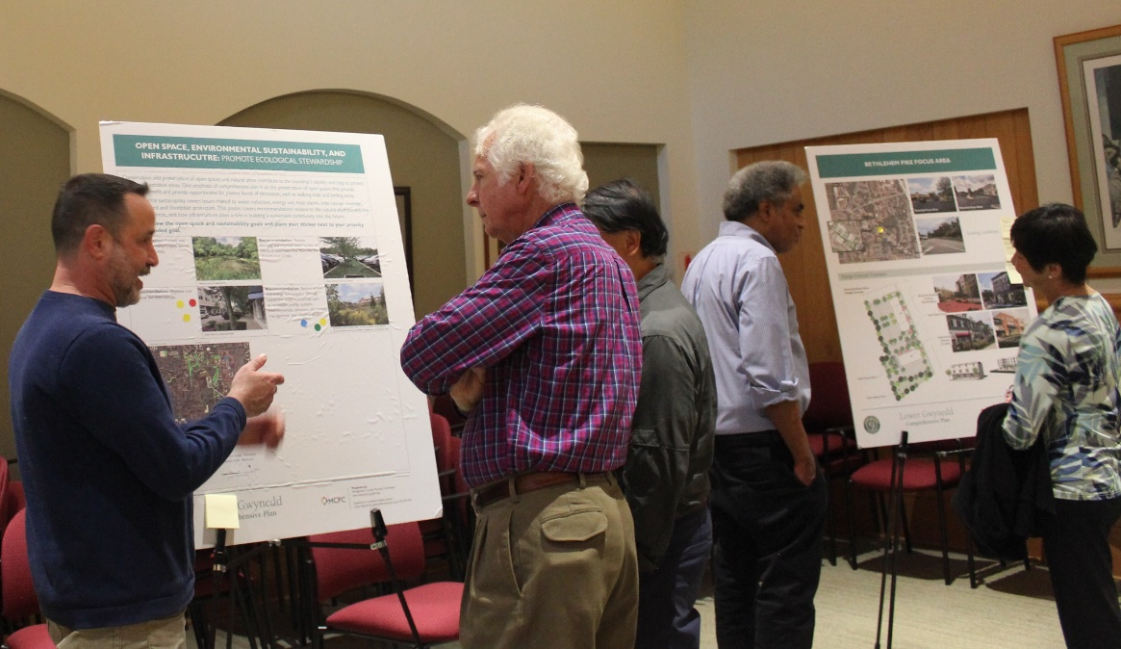
Public Engagement
Attended Fall Fest 2023
Community survey – Summer-Fall 2023
(533 responses)
1st Open House – October 2023
Draft Vision Statement Survey – Summer 2024
(87 responses)
2nd Open House – October 2024
Draft goals and recommendations survey – October 2024
(24 responses)
Ongoing social media and newsletter posts, page on the township website for people to see updates

Slide 5
Plan Organization and Topics Covered
Introduction and Vision Statement
Future Land Use Plan and Implementation
Place and People (demographics, jobs and employment)
Housing and Neighborhoods (housing trends, affordability)
Transportation (commuting patters, traffic calming, walkability)
Open Space Trails and Parks
Environmental Sustainability and Infrastructure (natural resources, water/sewer, energy, waste reduction)
Historic and Cultural Resources
Community Facilities and Institutions (schools, health and social wellbeing)
Bethlehem Pike Focus Area

Slide 6
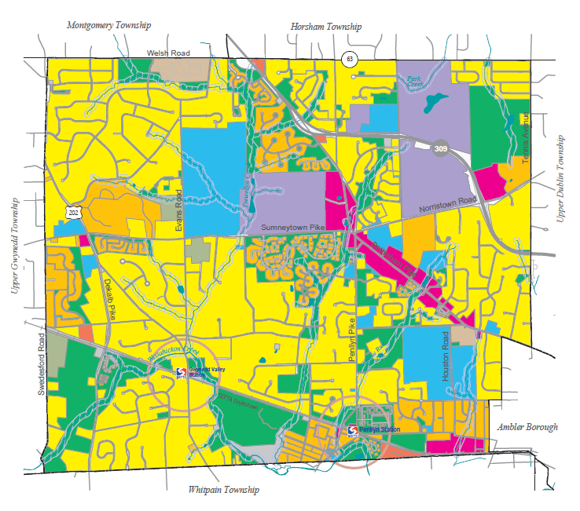
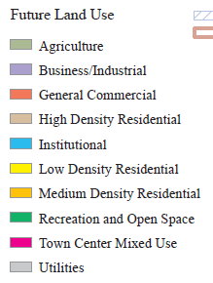

Future Land Use Map
Future Land Use Categories

Slide 7
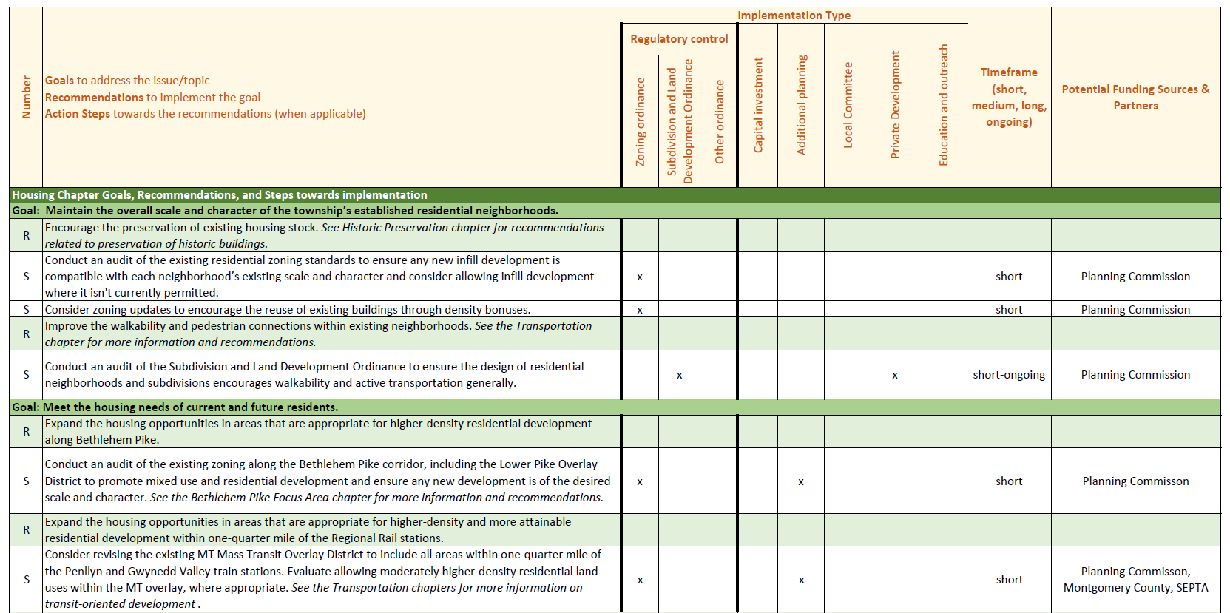
Implementation Plan
Community Vision
Goals
Recommendations
Action Steps

Slide 8
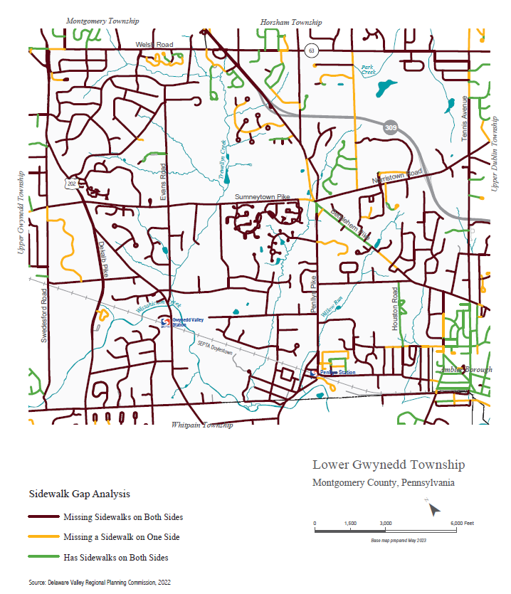
Transportation
Provide for safe mobility and connections
Sidewalk Gap Analysis
Takeaways
Most people (68%) drive alone to work
In 2022, 20% of people worked from home; 2% of people took transit to work
Crashes occur and people are concerned about road safety
Walkability (and bikeability) is important

Slide 9
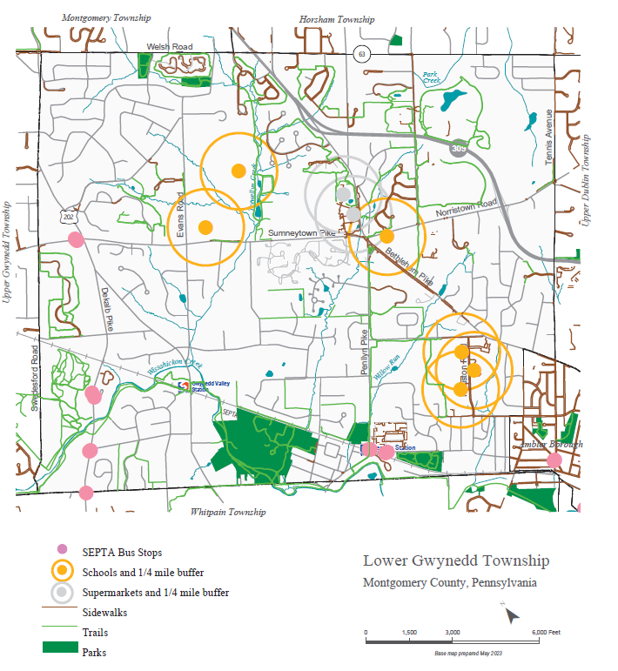
Walkability Analysis
Transportation
Provide for safe mobility and connections
Goals and Recommendations
Goal: Improve road safety and slow vehicle travel speeds through residential neighborhoods.
Identify common high-speed streets and install traffic calming strategies .
Goal: Ensure safe and accessible pedestrian and bicyclist connections between the township’s residential areas and priority walkability areas.
Continue to pursue opportunities to expand and improve the sidewalk network and to implement intersection crossing safety improvements.
Ensure safe and convenient bicycling routes to destinations
Goal: Encourage the use of public transportation.
Install pedestrian connections with wayfinding signage to train stations.
Encourage suitable transit-oriented development within walking distance to the SEPTA regional rail stations.
Encourage bus stop improvements during land developments

Slide 10
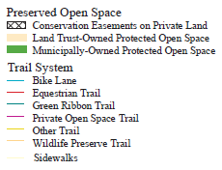
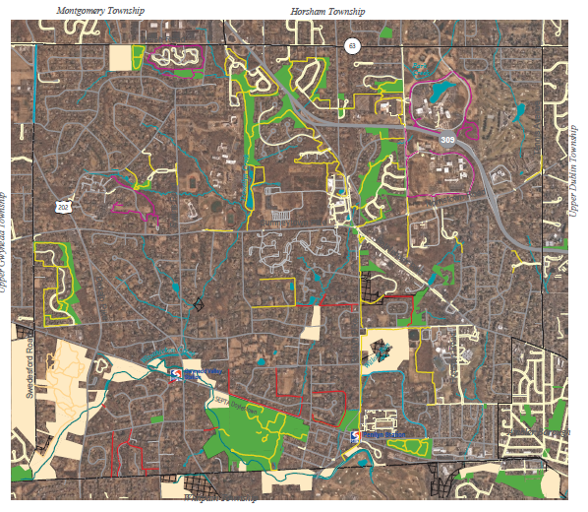
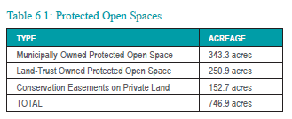
Open Space, Trails, and Parks
Protect Community Assets
Takeaways
Nearly 750 acres of protected open space
Over 20 miles of walking trails
Completed Parks & Recreation Strategic Plan
Priorities: open space acquisition, construction of trails to bridge network gaps

Slide 11
Open Space, Trails, and Parks
Protect Community Assets
Goals and Recommendations
Goal: Protect and preserve the township’s remaining open space areas.
Explore opportunities for strategic open space acquisition, including historic properties, greenway corridors, and potential trail right-of-way.
Goal: Expand and improve upon the township’s trail network.
Study the connection to trails and prioritize gaps to fill to complete connections.
Consider creating an official map showing the township’s planned locations of future trail connections.
Goal: Enhance the township’s parks, recreation opportunities, open space, and natural resources.
Prioritize installation of sidewalks, trails, and on-road bike facilities to improve access to parks and open spaces.

Slide 12
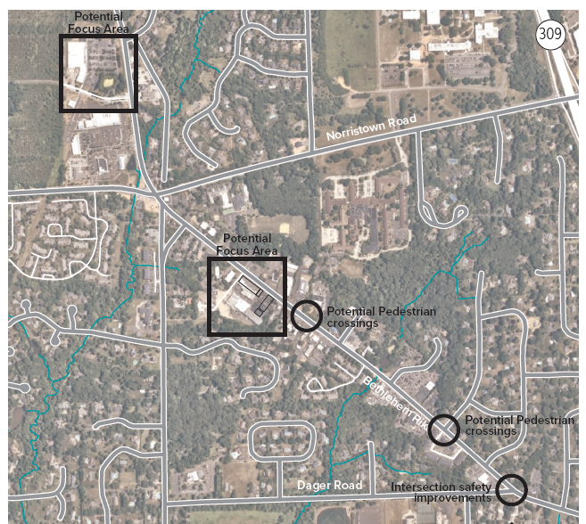
Bethlehem Pike Focus Area Study
Strategies to revive the commercial corridor
Takeaways
Support for improved streetscape to create a safer and more pleasant walking experience, through better building and pedestrian-oriented design.
The plan will provide design concepts that could be used as inspiration for potential redevelopment.

Slide 13
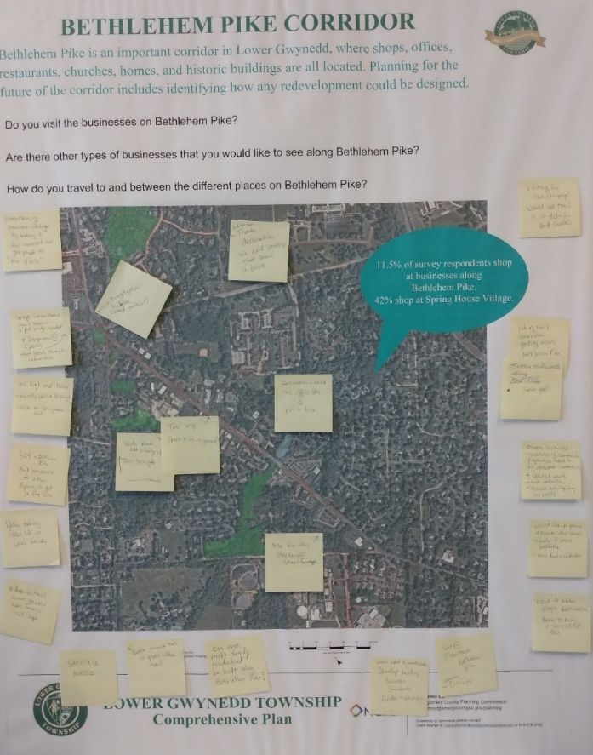
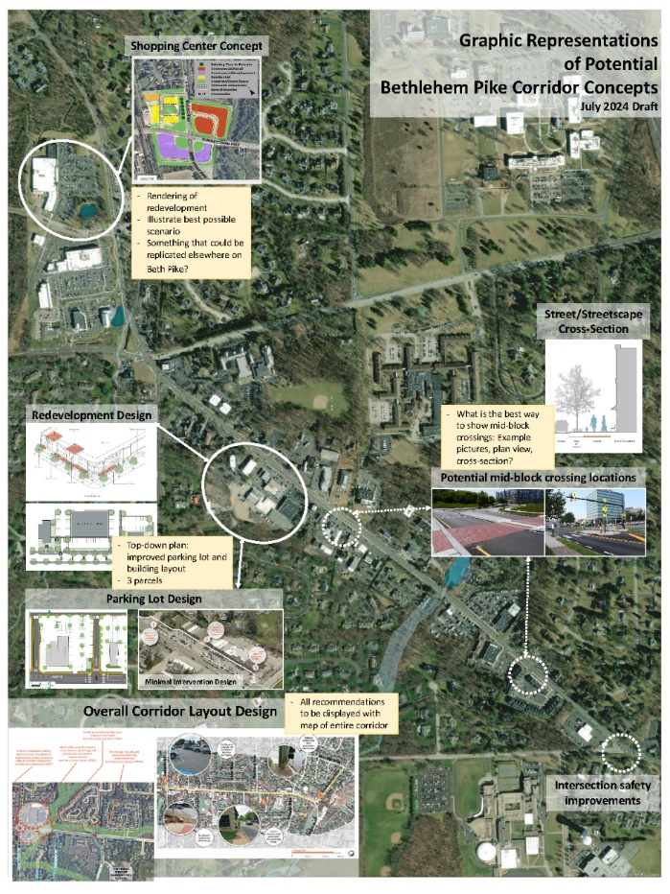
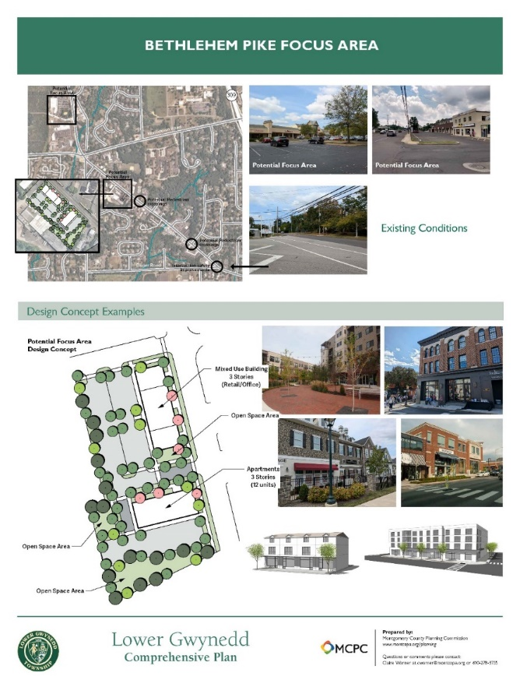
Bethlehem Pike Focus Area Study
Strategies to revive the commercial corridor
Public input process

Slide 14
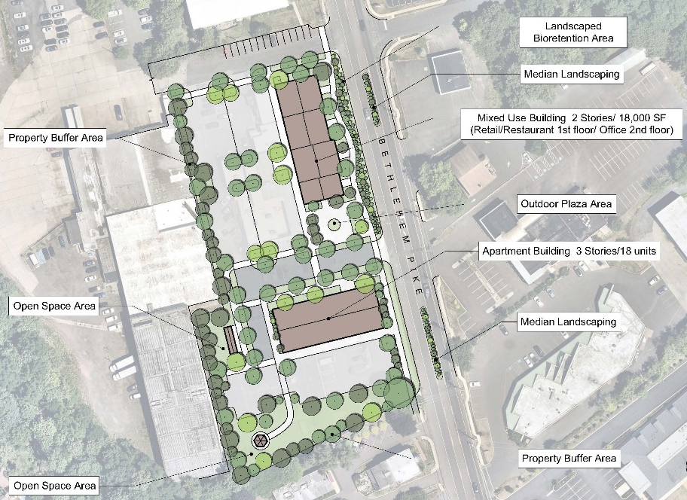
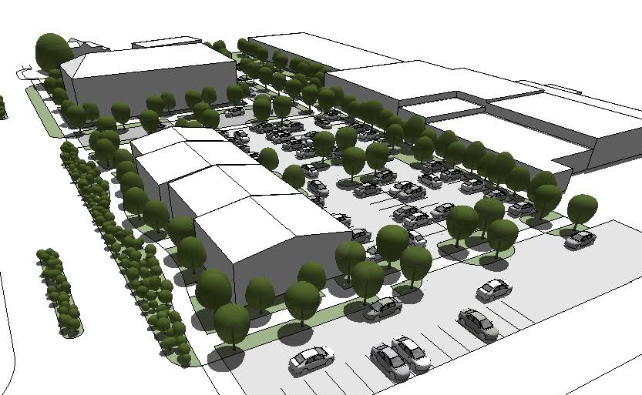
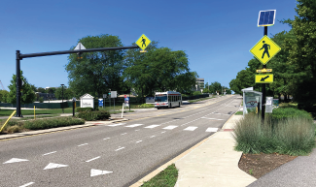
Bethlehem Pike Focus Area Study
Strategies to revive the commercial corridor
Goals and Recommendations
Goal: Encourage redevelopment of underutilized or vacant properties to create an inviting and interesting streetscape.
Implement building and streetscape design guidelines for all new development and redevelopment.
Goal: Create a safe and comfortable Bethlehem Pike for all people traveling along the corridor.
Consider roadway improvements that would add greenery and calm traffic along Bethlehem Pike.
Consider intersection safety improvements and potential locations for signalized and mid-block pedestrian crossings.
Consider the feasibility of bike lanes along Bethlehem Pike and how they could connect with the existing pedestrian and bicycle network (e.g. sidewalks and trails).

Slide 15
What’s Next:
  Review the draft Comprehensive Plan
    Review the implementation plan and action steps
  Adoption process
If you have questions or comments, contact:
Claire Warner, Senior Community Planner
clairewarner@montgomerycountypa.gov

