Slide 1
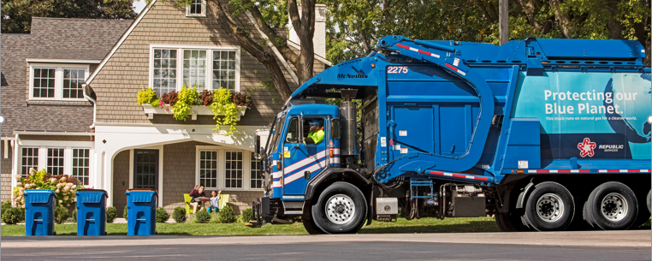

Industry Update
Municipal Recycling Information

Slide 2

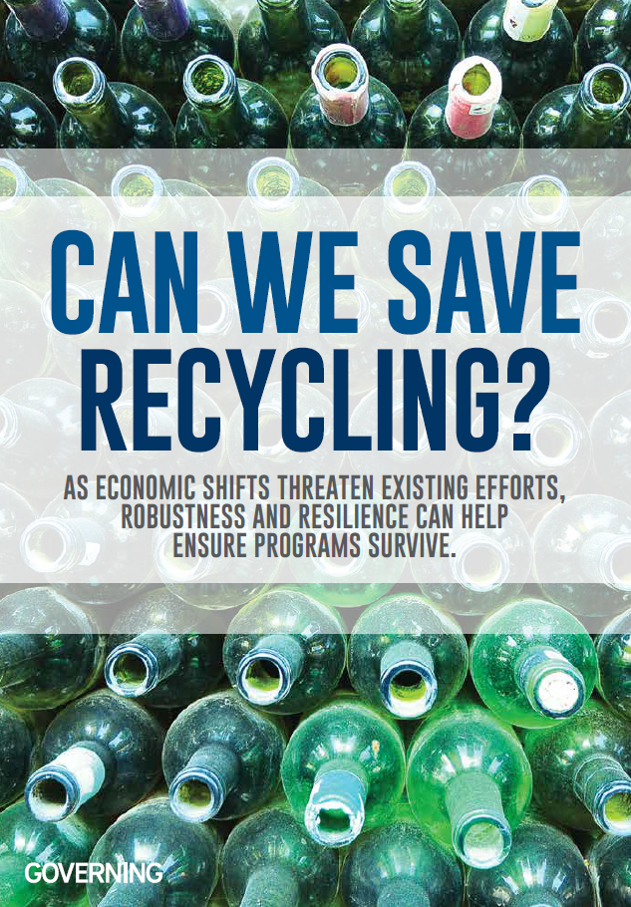

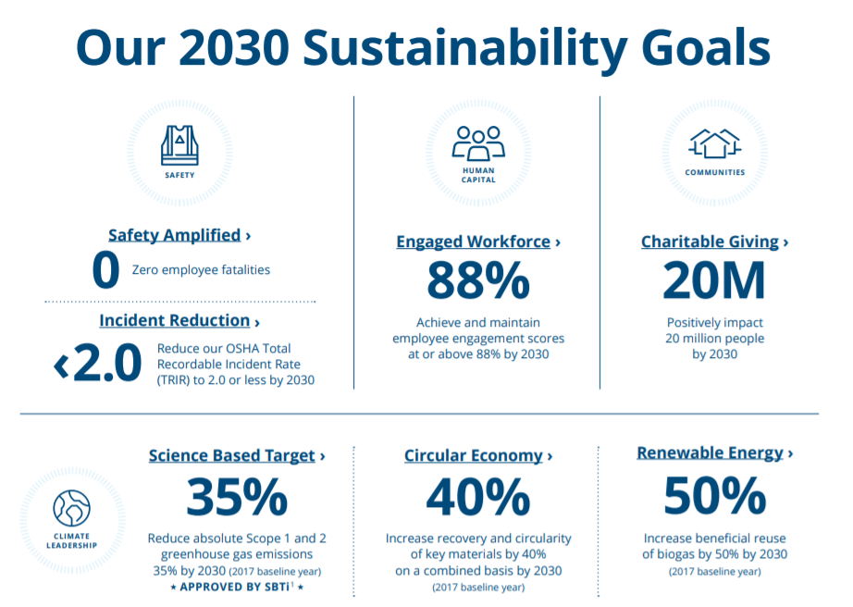
Top of Mind in 2021
COVID Pandemic Recovery
Reopening enabling partial volume recovery
Supply chain impacts to capital costs
Cases continue to hinder operations in some markets
China Sword / Recycling
Continued investments in domestic mills and capacity
Global capacity still well below pre-China Sword levels
2021 commodity markets up due to pandemic-induced demand
Industry Wide Challenges
National CDL driver and technician shortages driving wages up
Labor shortages attributed to pandemic (eg: Call Center agents)
Recycling
Paper
Plastics
Metals
The recycling and waste industry is far from “normal” in 2021.
We continue to navigate multiple unanticipated headwinds.
2

Slide 3
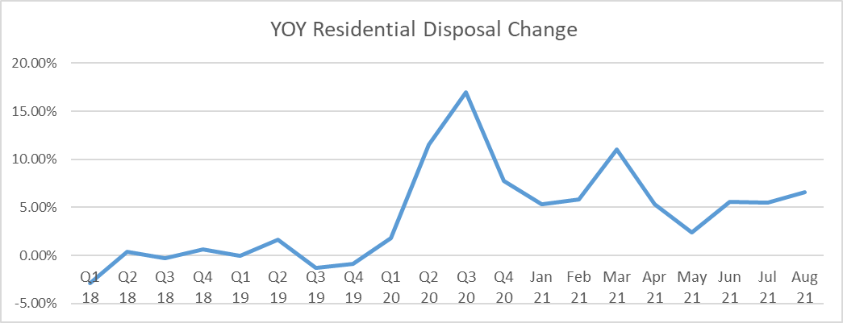
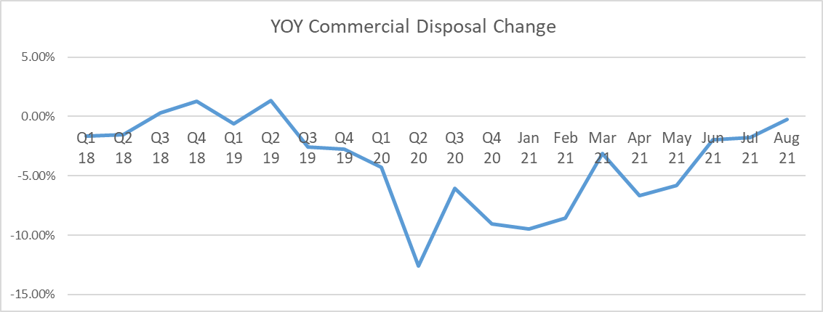
Pandemic Volume – Resi Remains Elevated
Residential
Volume mirrors attempts to restore mobility
Consistent increase over pre-pandemic levels, driven by continued work-from-home realities
Commercial
Volumes mirror slow reopening of businesses
Close to pre-pandemic averages
Industrial
No significant changes
Are residential volumes at a new norm?
Continued work-from-home volume drives economic headwinds from additional disposal costs, in the lowest price line of business.
3

Slide 4
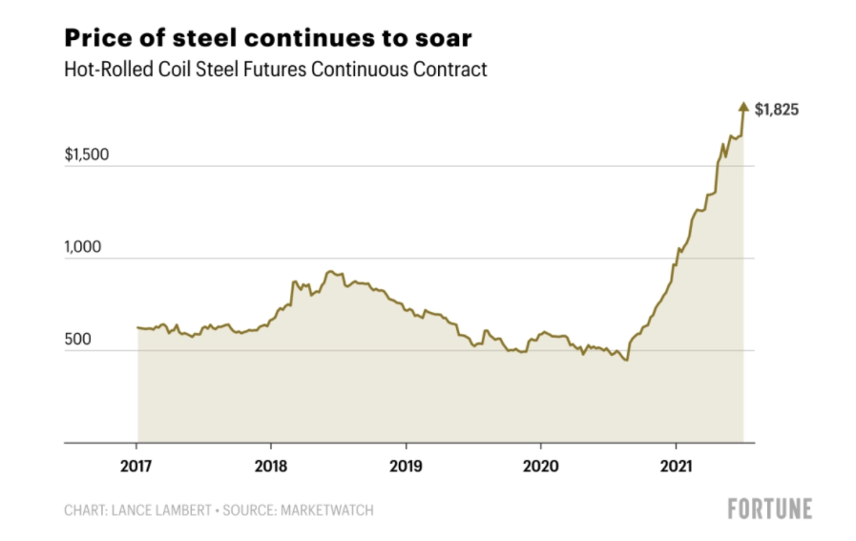
Pandemic Impacts to Supply Chain and Capital
Our industry is extremely capital intensive, requiring careful navigation of escalating costs.
4

Slide 5
Recycling: Commodity Trends
% of Republic Services Material Sold
China Sword
Pandemic
2019
2020
2021*
PET
4.5%
4.9%
4.5%
Steel
1.8%
1.6%
1.3%
Alum
1.2%
1.4%
1.3%
OCC
50%
53%
54%
Mix Paper
25%
23%
24%
Source: STIFEL, June 2020 and June 2021
* - 2021 “Basket” is based on Jan. through July data
Residential tons are up… and commodity values are improving.
Is your Municipality missing out on the upside?
5

Slide 6




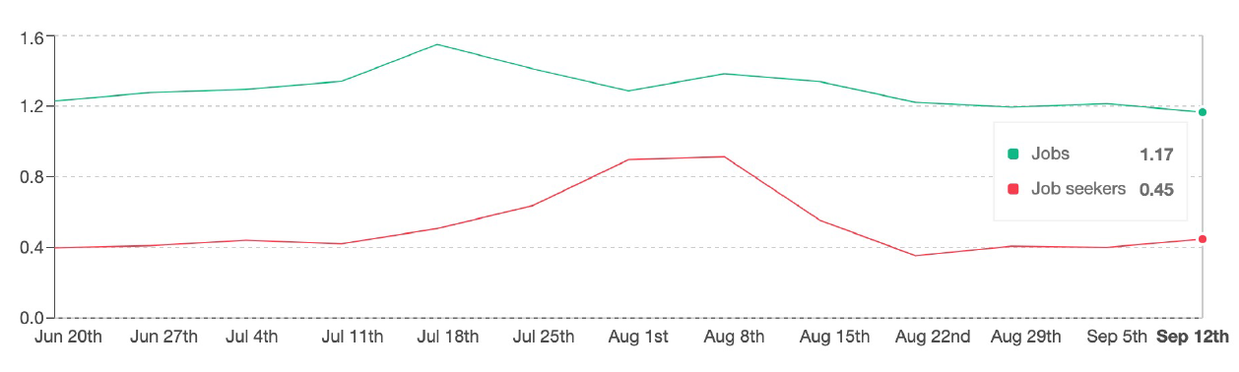
National CDL Driver Shortage
Fewer Drivers – Younger workers are not entering the driver industry at a rate high enough to replace an aging driver workforce
Growing Gap – Open positions vs applicants
  CDL Job Volume +17%
  CDL Job Seeking -55%
Sources: Coyote Collective Report, EMSI Report, 2021
Indeed – US Data, August 2021
The growing gap between positions and applicants are forcing companies to offer higher pay, including $5-10k signing bonuses and more time off.
6

Slide 7
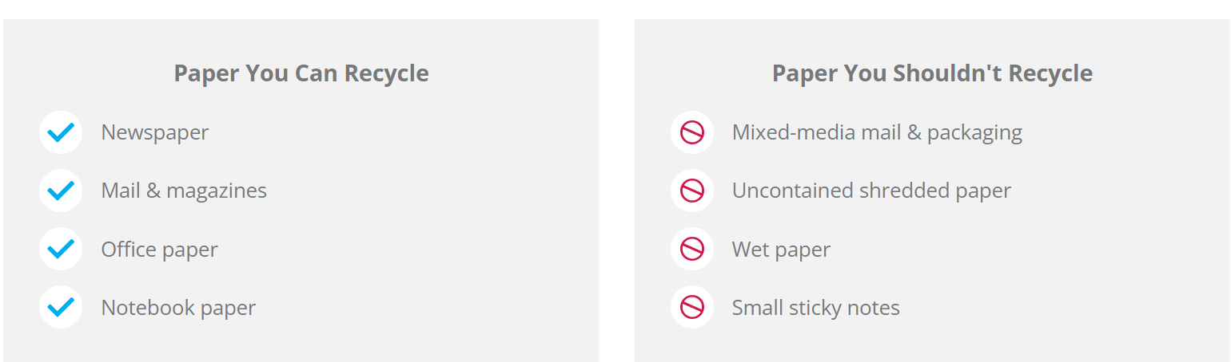
Paper Recycling
Is It Larger Than a Credit Card?
Is It Mixed with Other Materials?
Is the Paper Dry?

Slide 8
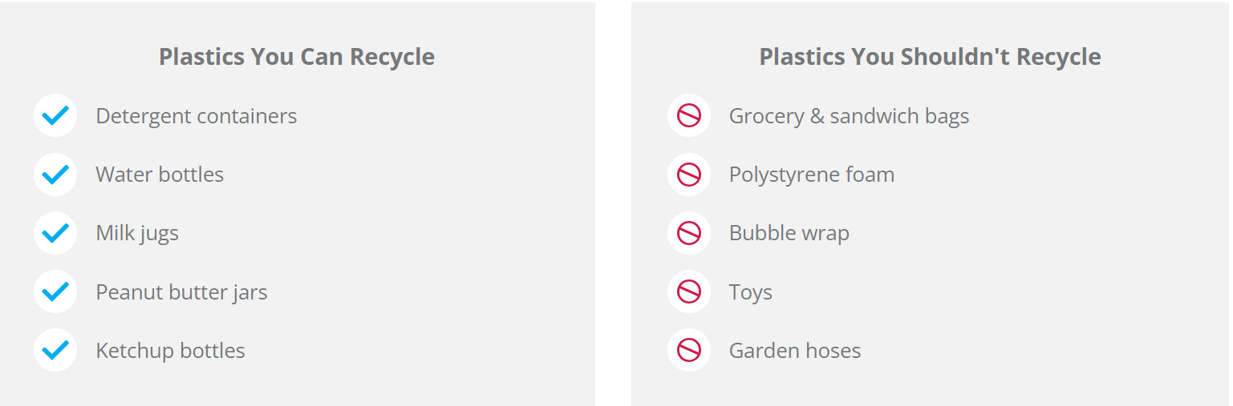
Plastics Recycling
Is It Empty. Clean. Dry.
Does It Pass the Poke Test?
Is It Contained in a Plastic Bag?

Slide 9
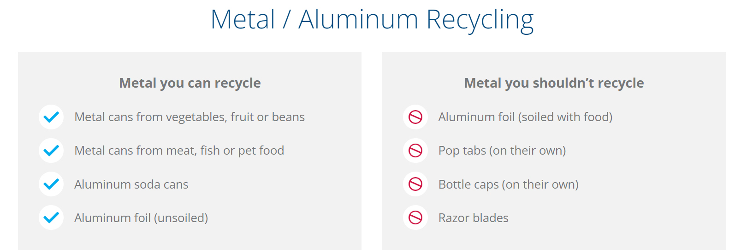
Metal Recycling
Is It Empty. Clean. Dry.
Does It Pass the Poke Test?
Is It Contained in a Plastic Bag?

Slide 10
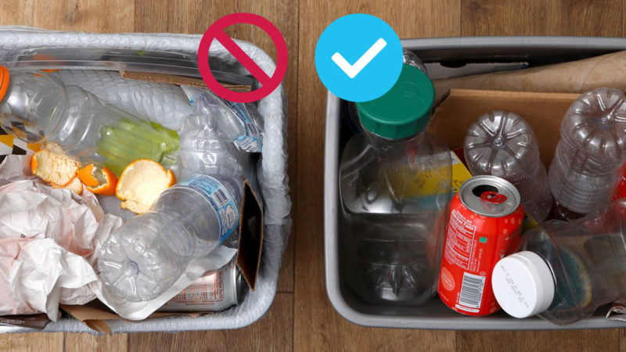
General questions
Republic Services Materials Recycling Overview
https://www.youtube.com/watch?v=6Bwlii0m39M
10

