Slide 1
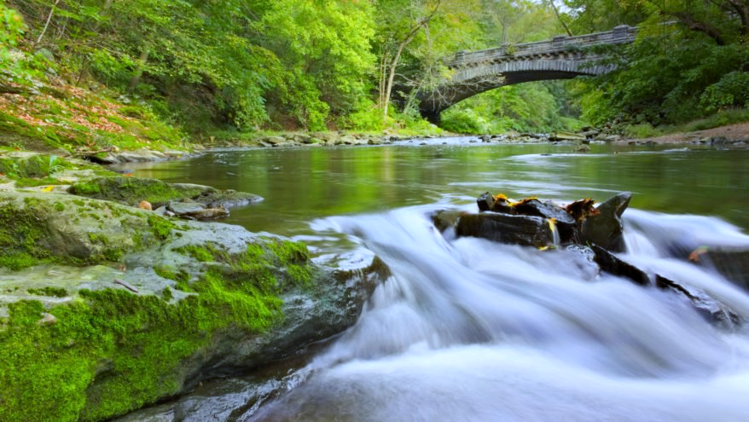
Wissahickon
Clean Water Partnership
Presentation on the
Water Quality Improvement Plan
To Lower Gwynedd Township

Slide 2
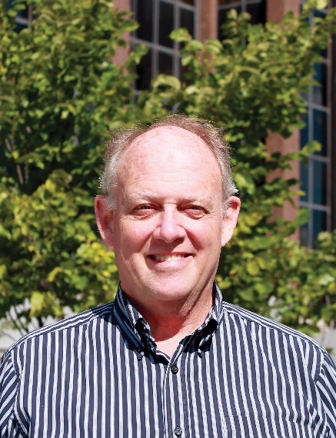
PRESENTERS
Brandon Ford
Watershed Partnership Co-Chair
Asst. Township Manager,
Springfield Township
Drew Shaw
Environmental Planning Manager,
Montgomery County Planning Commission
Erin Landis
Water Programs Manager,
Wissahickon Trails
2

Slide 3
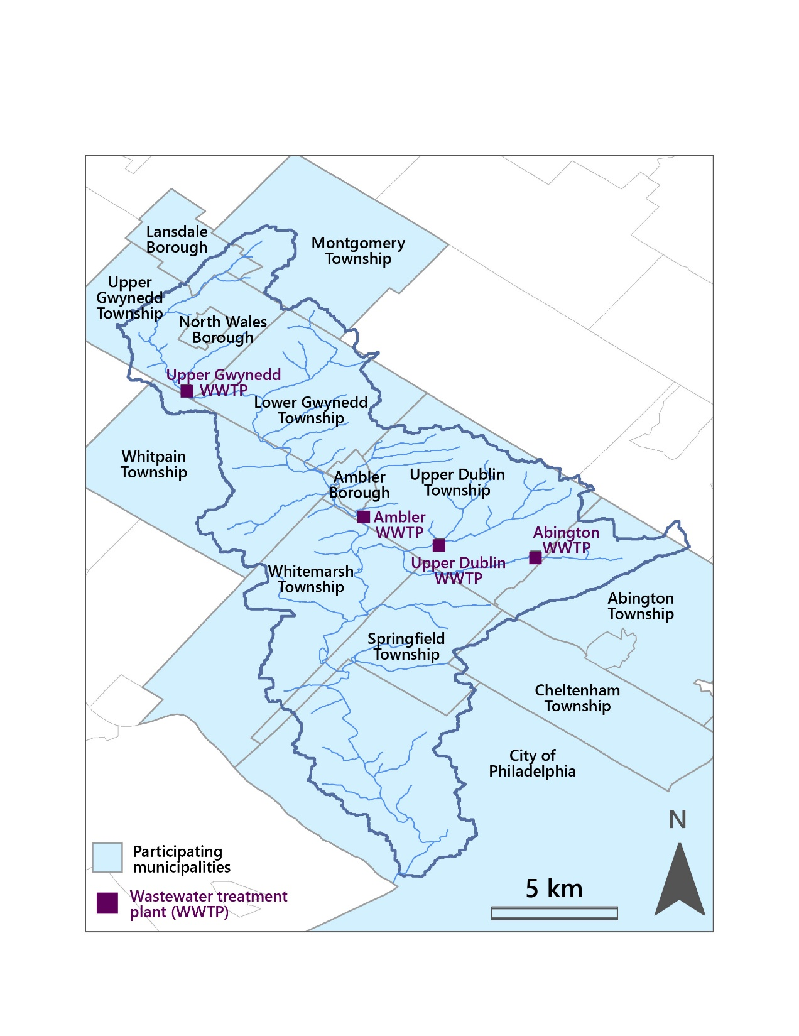
ABOUT THE PARTNERSHIP
A voluntary collaboration of over a dozen municipalities and four wastewater facilities:
Abington Township
Ambler Borough
Cheltenham Township
Lansdale Borough
Lower Gwynedd Township
Montgomery Township
North Wales Borough
Springfield Township
Upper Dublin Township
Upper Gwynedd Township
Whitemarsh Township
Whitpain Township
City of Philadelphia
3

Slide 4
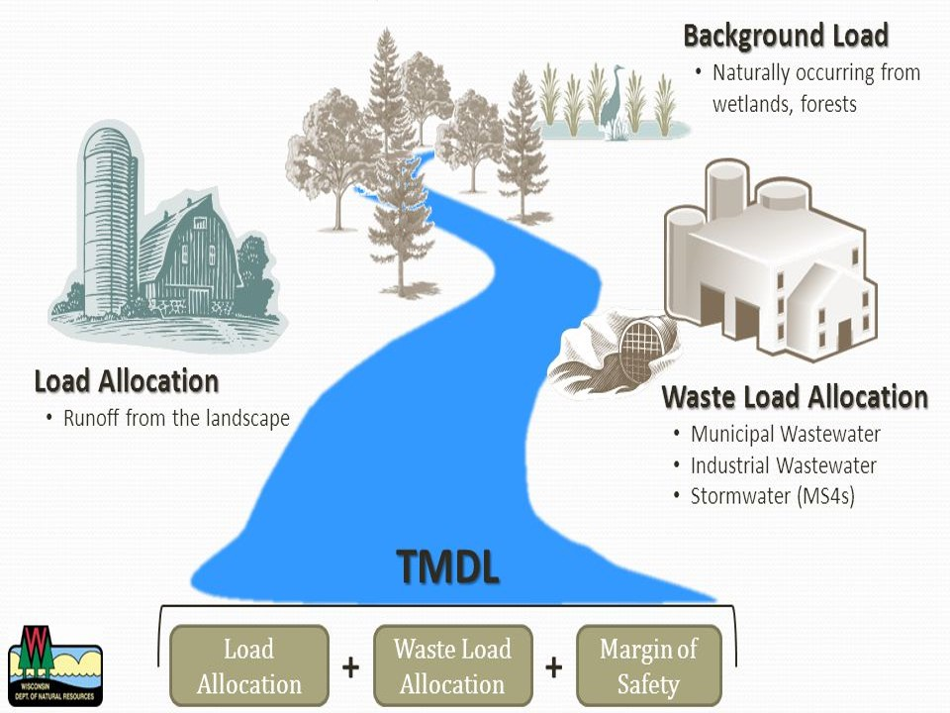
WHAT IS A TMDL? Total Maximum Daily Load
4

Slide 5
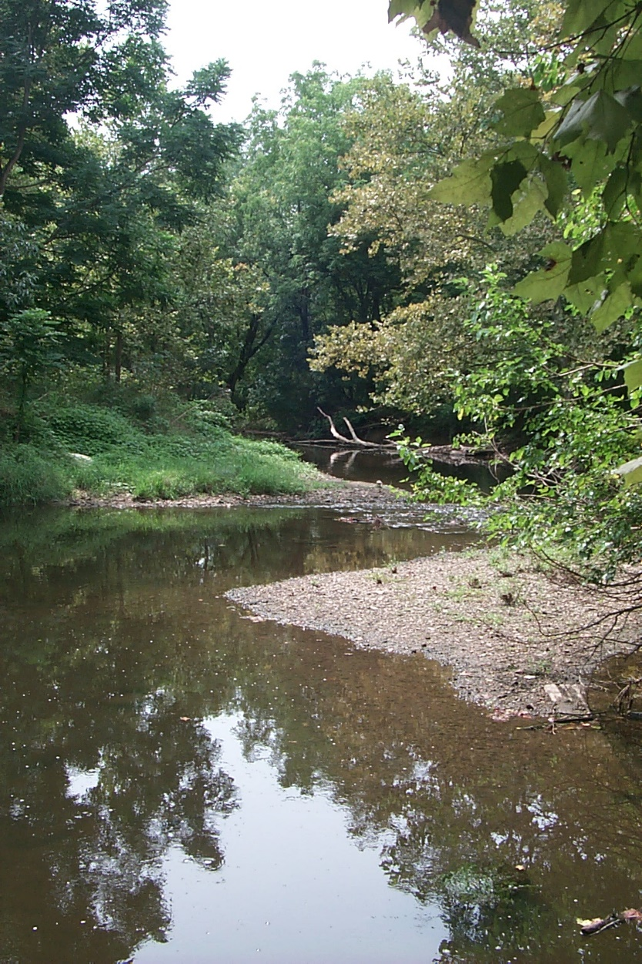
WHAT IS A WATER QUALITY PLAN?
A locally-driven alternative to the costly and time-consuming TMDL requirement mandated by PA DEP
An adaptive, flexible management plan to improve water quality and habitat
Continually incorporates new data and information and opportunities to positively impact the watershed over time.
Some projects include, but not limited to:
Streambank Stabilization
Basin Retrofits/Naturalizations
Habitat Restoration
Riparian Buffers
5

Slide 6
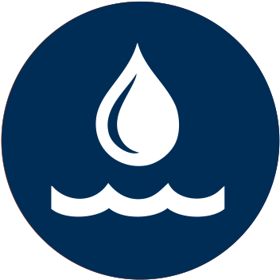
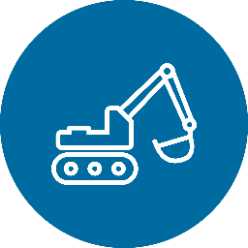
BENEFITS OF WORKING TOGETHER
HOLISTIC APPROACH by addressing water quality and stormwater across the entire watershed vs. individually
ENDURING PARTNERSHIPS that emphasize mutual assets, pooled resources, & shared purposes to meet obligations
INCREASE CAPABILITY in tackling regional challenges that would be more difficult and costly if addressed alone
ECONOMIES OF SCALE by capitalizing on cost savings of larger projects with the cost spread over the partnership
6

Slide 7
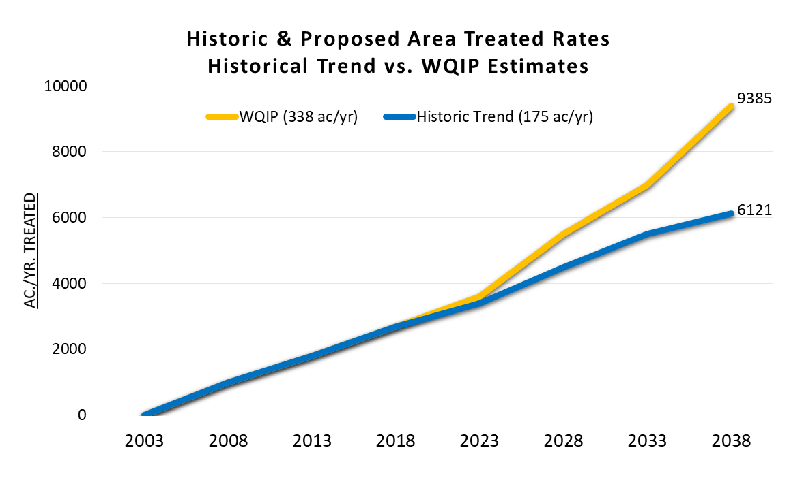
HAVING A BIGGER IMPACT
WQIP = Water Quality Improvement Plan
7

Slide 8
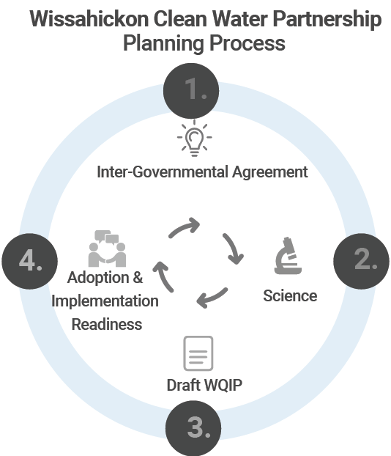
ACCOMPLISHMENTS
INTER-GOVERNMENTAL AGREEMENT SIGNED
DATA COLLECTED & SCI. MODEL DEVELOPED
Collaborated with technical consultants and Temple University to collect data and project WQIP impact
WATER QUALITY PROJECTS IDENTIFIED
Multiple methods of analysis including modeling of the watershed have been used to identify priority projects
DRAFT WQIP FINALIZED & SUBMITTED
NEGOTIATED WITH REGULATORS ON WQIP
Met with state and federal regulators to revise draft WQIP and resubmit for approval.
8

Slide 9
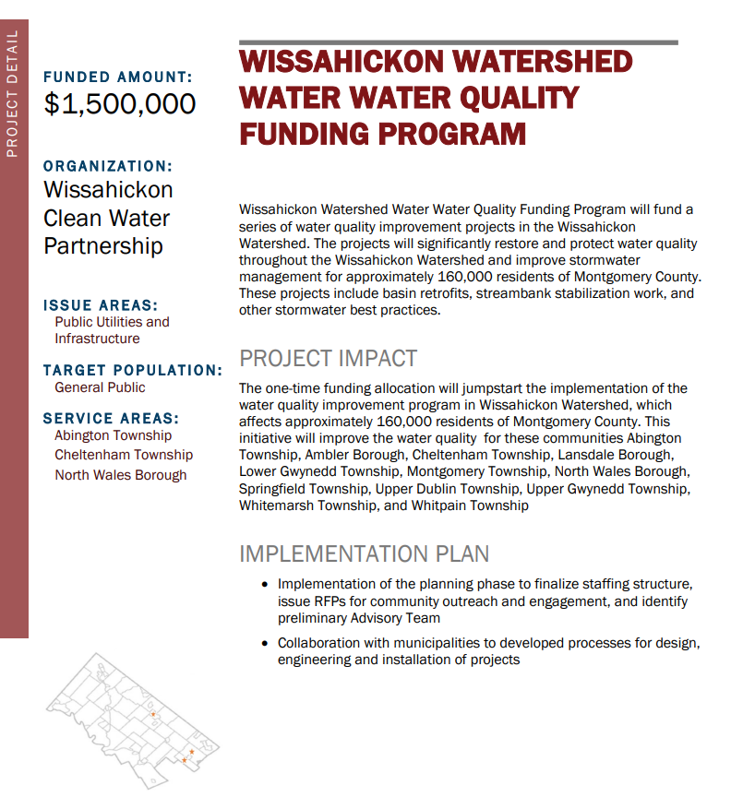
AVAILABLE FUNDING
AWARDED $1.5 MILLION IN COUNTY FUNDS FOR PROJECTS
Projects will be selected based on readiness and watershed-wise impact
Projects must be identified by 2024
Construction must be completed by December 31, 2026.
9

Slide 10
NEXT STEPS
Submit Revised WQIP based on Regulator Feedback
Finalize Implementation Inter-governmental Agreement
Select & Design
Implementation Projects
Receive approval of WQIP & Proceed with Implementation
10

Slide 11
Wissahickon
Clean Water Partnership
QUESTIONS?

